Slide 1
Keeping HP-UX Up-To-Date and Patching
Best Practices
Dusan Baljevic, HP Customer Education
Sydney, Australia

Slide 2
Acknowledgements
These slides have been used in various presentations in Australia over the last several years. This is a work-in-progress and updates are frequent. I bear full responsibility for any error, even though it is purely unintentional.
I cannot claim credits solely, nor can I claim that I know everything about Unix. I consider myself to be a Unix Apprentice.
Wisdom of many helped in creation of the presentation (seminars at HPWorld, ITRC/HPSC forums, HP Ambassadors and Unix Profession members, HP Education courses, individual contributions on the Net).

Slide 3
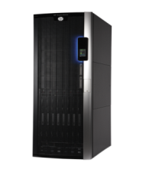
HP-UX Network Design
At a minimum, three fully-firewalled, separate networks are recommended for HP-UX servers. It is assumed that such best practice is enforced.
Corporate and Management LAN can be an Auto Port Aggregate (APA).
Management LAN is typically used for protocols like NTP, DNS, LDAP, remote Ignite-UX, remote SD-UX, DHCP for clients, LAN-based backups, and similar.
Console LAN
(ILO, GSP)
Corporate LAN
Management (Confined) LAN

Slide 4
Seminar Agenda
  All commands and features listed in the presentation apply to
  HP-UX 11iv3. Similar would apply to older releases, where applicable.
  HP-UX Patching Versus Update-UX
  Update-UX
  HP-UX Patch Management Concepts
  Installing, Verifying, Removing, and Committing HP-UX Patches
  HP-UX Patch Management with SD-UX Depots
  HP-UX Patch Management with Software Assistant (SWA)
  HP-UX Patch Management with Dynamic Root Disk (DRD)

Slide 5
HP-UX Patching Versus Update-UX

Slide 6
HP-UX Patching Versus Update-UX 1 of 3
Full update-ux process is strongly recommended and preferred to standard patching.
The update-ux method is quite safe and there are no “loose points”.
If possible, we also encourage customers to use Software Assistant (SWA) on a regular basis.
Patch bundles will patch existing software, but update-ux will update products (the core O/S, all the drivers and even independent software units that will not be updated during patching).

Slide 7
HP-UX Patching Versus Update-UX 2 of 3
The update-ux method is not only used to update from a lower to a higher version (for example, 11i v2 to v3), but also to update from an older to a newer release within the same version.
For many reasons, we encourage usage of update-ux with Dynamic Root Disk (DRD).
If O/S is upgraded through update-ux process, the best practice recommends cold installs; incremental upgrades might create possibility that some obsolete software and libraries exist afterwards.

Slide 8
HP-UX Patching Versus Update-UX 3 of 3
We recommend customers develop a release “cycle” through DRD implementation:
Run update-ux every year (18 months or maximum two
years is acceptable in some circumstances). Only break
this cycle if they must have some new functionality in a
bi-annual release.
Unless specifically requested differently, the
patch/update level should be at latest release, if
practicable, or LATEST-1.

Slide 9
HP-UX Patch and Update Management
Patch/update management is a quite complex and involved topic.
There is no patch/update management plan that fits all situations.
Every company must determine the plan that fits best in their own environment and meets their business objectives.
A plan should be reviewed periodically because the environment and business objectives change over time, new tools and practices evolve, and operating systems evolve. All of these changes require modifications to existing patch management plans.

Slide 10
HP-UX Operating Environment 1 of 4
HP strongly recommends that only a complete OE be installed and that no removal of Required products and bundles in the OE occur, unless Independent Software Unit (ISU) products are used.
HP-UX 11i OEs have been packaged and tested as complete solutions.
HP-UX 11i releases are delivered bi-annually (for 11iv3 it is typically in March and September).

Slide 11
HP-UX Operating Environment 2 of 4
As of HP-UX 11iv3, ISUs are no longer delivered via the standard patch process or scheduled bi-yearly updates. For ISU products, defect fixes, performance enhancements, and new functionality, are delivered using the ISU model.
ISUs are additional layered software products.
Each ISU update is cumulative so customers only need to install the latest update to receive all defect fixes, performance enhancements and updated functionality.

Slide 12
HP-UX Operating Environment 3 of 4
A mechanism for handling OE subsets is not available. Installing applications delivered with an OE separate from the entire OE will not include those applications in the OE bundle wrapper, preventing some operations from identifying them as part of the OE. Installing or removing individual products in the OE may also impact the quality of the OE. If you choose to add or remove individual OE products to an 11i system or remove a product from an installed OE, be sure to specify all filesets listed for the target product.
Omitting a fileset will prevent the product (or other products that depend upon that fileset) from functioning and could hang the system.

Slide 13
HP-UX Operating Environment 4 of 4
DRD only supports updating from 11.31.0709, 11.31.0803, or 11.31.0809 to 11.31.0903 or later releases. DRD may not be used to update from 11i v2 to 11iv3 (although it has been shown to work very well).
In a DRD scenario, update can be done with following alternatives.
From a active disk run drd runcmd update-ux, drd will run update on inactive disk. Active disk will not be altered. This option is not officially supported for 11iv2 to 11iv3 update. *
Boot the inactive disk (activate the clone) and run update-ux command on it. Active disk will not be altered.
Run update-ux on active disk. Inactive disk (clone) will not be altered.
Notes:
* Dusan’s personal comments:
The update-ux method is not only used to update from a lower to a higher version
(for example, V2 to V3), but also to update from an older to a newer release within
the same version.
Even then, HP’s official stance is:
If O/S is upgraded through update-ux process, the best practice recommends cold
installs; incremental upgrades might create possibility that some obsolete software
and libraries exist afterwards.
update-ux works and is supported for HP-UX V2 to V3 upgrade on LIVE disk, so why we not have the same
with DRD…
The only on-line and WITHOUT AFFECTING PRODUCTION ENVIRONMENT for HP-UX version of
11iv2 to 11iv3 update is:
From an active disk run “drd runcmd update-ux”, drd will run update-ux on
inactive disk and does the update on inactive disk. Active disk will not be altered.
The other two alternatives would require the customer to stop
applications, quiescent the server, and then apply the update.

Slide 14
Examples How to Check HP-UX OE
# swlist | egrep “\-OE”
# swlist -l fileset -a install_date | grep OE
# swlist -a install_date OS-Core
# /opt/ignite/bin/print_manifest
14

Slide 15
HP-UX 11i v3 Boot Disk Cloning 1 of 2
If internal disks are used for booting, they should be on different controllers.
It is a crucial requirement to allocate one or two disks (or LUNs) for boot disk cloning - Dynamic Root Disk (DRD).
Creates a "point-in-time“ O/S image,
On-line patching and configuration changes of the inactive O/S,
Easier change management approvals because the active O/S is not affected (risk is eliminated),
Some tasks make dynamic changes of the O/S during the cloning, without affecting the active O/S,
Boot disk mirroring does not prevent disasters caused by human errors,
If boot disks are on the same controller, mirroring is not a perfect protection.

Slide 16
HP-UX 11i v3 Boot Disk Cloning 2 of 2
With DRD, future upgrades and patching are very easy.
It is strongly discouraged to use root volume group for any third-party applications.
/var/tmp must have at least 32 MB free (if make_tape_recovery is used, the space is needed for LIF volume assembly).

Slide 17
HP-UX Backups
Ensure that operating system backups are in place before the server is moved into production. Typically, Ignite-UX based backups, DRD, or SAN-based LUN snapshots are recommended.
Ignite-based backups shall not include any non-root volume groups.
Examples of Ignite backups to local tape drive and via network:
# make_tape_recovery -x inc_entire=vg00 -x exclude=/tmp
# make_net_recovery -s srvname -n 3 -P s –x \
inc_entire=vg00 -d "Archive of myclient“
Ensure that all applications and databases are backed up via proper (typically commercial) tools.

Slide 18
Update-UX

Slide 19
Update-UX Examples 1 of 2
Install updated O/S release from local depot
# swinstall –s /mydepot Update-UX
# update-ux -s /mydepot/11iv3VSE-OE HPUX11i-VSE-OE
Install updated O/S release from local CD-ROM or DVD
# swinstall –s /DVD Update-UX
# update-ux -s /DVD HPUX11i-DC-OE
Install updated O/S release from local depot via DRD
# drd runcmd swinstall –s /mydepot Update-UX
# drd runcmd update-ux -s /mydepot/11iv3VSE-OE \
HPUX11i-VSE-OE
# drd activate ...
19

Slide 20
Update-UX Examples 2 of 2
Install updated O/S release from remote depot interactively
# update-ux -i -s remsrv:/depot
Install updated O/S release from remote depot
# swinstall –s remsrv:/depot Update-UX
# update-ux -s remsrv:/depot/11iv3VSE-OE \
HPUX11i-DC-OE
Install updated O/S release from local depot via DRD
# drd runcmd swinstall –s /mydepot Update-UX
# drd runcmd update-ux -s /mydepot/11iv3VSE-OE \
HPUX11i-VSE-OE
20

Slide 21
HP-UX Patch Management Concepts

Slide 22
Why HP-UX Patches?
HP releases patches for a variety of reasons:
* New functionality,
* New hardware support,
* Bug fixes (including security issues),
* Performance enhancements.
Lack of attention to this topic can lead to data loss, financial loss, exploits of vulnerabilities, damaged reputation, and other negative consequences.

Slide 23
HP-UX Patch Best Practices 1 of 4
Unless specifically requested differently, the patch level should be at latest release, if practicable, or LATEST-1. Main reasons for patching: stability and security.
Unless specifically requested differently, regular patch audit should be enforced (via Remote Services, Software Assistant, HPSC* Patch Assessment, and similar offerings and tools).
Four basic strategies are:
* Proactive patch management (patching regularly to avoid problems).
* Reactive patch management (patching after problem occurs).
* Security patch management.
* Install a new system (to replace old or un-patched one) .
Notes:
* HPSC is what used to be ITRC

Slide 24
HP-UX Patch Best Practices 2 of 4
Reactive patch management:
* Fix an existing problem or security vulnerability;
* Relatively unplanned activity.
Proactive patch management:
* Avoid potential problems;
* Improve system reliability and availability;
* Enable new hardware or software features;
* Improve system performance;
* Planned activity.

Slide 25
HP-UX Patch Best Practices 3 of 4
Ideally, the strategy should include proactive patching, reactive patching, and a separate plan for security patches..
Deploying patches should have three distinct processes:
* Patch testing.
Patches should be installed on one or more levels of
preproduction systems and perform testing;
* Planning deployment;
* Installing patches.

Slide 26
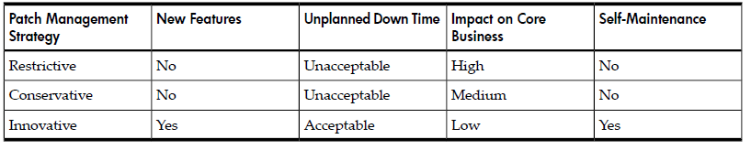
HP-UX Patch Best Practices 4 of 4
There are three factors for patch strategy:
* Restrictive;
* Conservative;
* Innovative.
The decision must be based on:
* Risk levels;
* Maintenance window;
* Number of local or remote systems involved;
* Uniqueness of system configuration;
* System and application availability.

Slide 27
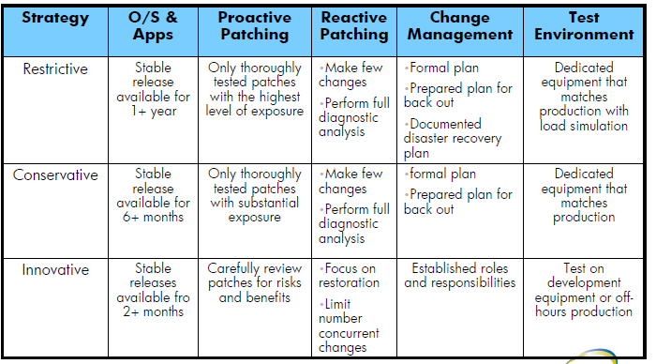
HP-UX Patch Strategy

Slide 28
HP-UX Patch Naming Convention
HP patches follow a naming convention.
Note that PHKL patches usually require a system reboot.
Check patch README before installing.
The Patch name format is: PHxx_yyyyy, where:
  PH = Patch HP-UX.
  xx = Area patched:
      CO - general HP-UX commands.
      KL - kernel patches.
      NE - network specific patches.
      SS - all other subsystems and applications.
  yyyyy = Unique number (positive four or five-digit integer)
Notes:
[Course Title]
[Module Title]
[Rev. # or date] – © 2008 Hewlett-Packard Development Company, L.P.

Slide 29
HP-UX Patch Supersession Chain
Patches from HP are usually cumulative.
Later patches may “supersede” older patches.
The final patch in a supersession chain provides a superset of the features and fixes provided by its predecessors.
If regular patching is not implemented, it is sufficient to install the latest patches.
Patch numbering scheme does not follow any pattern that ordinary users can understand.
Other vendors might release patches for their own HP-UX products in different formats (tar, cpio, zip, and so on).
FOO-RUN
PHCO_10237
PHCO_14721
PHCO_26118
superseded by …
superseded by …
superseded by …
29
Notes:
[Course Title]
[Module Title]
[Rev. # or date] – © 2008 Hewlett-Packard Development Company, L.P.

Slide 30
HP-UX Patch Ratings
HP assigns every patch a rating, indicating how thoroughly the patch has been tested.
Visit the ITRC patch database to determine patch star rating.
Some customers only install 2- and 3-star patches.
Type | Description
 | HP has done functional testing to verify that the patch fixes the problem that it purports to fix. Unwanted side effects were not discovered.
 | Patch has been installed in a reasonable number of customer environments with no problems reported.
 | Patch has been stress- and performance-tested by HP in simulated customer mission-critical environments using common application stacks.
30
Notes:
HP-UX patches have a corresponding quality rating called the HP rating. HP assigns a patch rating of 1 (numeral or star) to each HP-UX patch when it is released. Over time, HP might update the rating value to 2 or 3 (numeral or stars) to convey increased confidence in the patch. The higher the rating, the lower the risk of side effects and the more suitable the patch is for mission-critical environments.
You can use the ITRC's Patch Database to find the rating value for a specific patch. The ITRC graphically represents a patch's rating by displaying one to three stars beside the patch ID in the results of a patch search. “Obtaining Information Using the ITRC” provides details on how to do this.
If HP learns of a problem caused by or exposed by an HP-UX patch, HP issues a patch warning describing the problem and ceases recommending the patch, but does not change the patch rating. If a patch has a warning associated with it, you will no longer be able to view the rating on the ITRC's Patch Database. For more information on patch warnings, see “Patch Warnings”.
The following rating related information pertains only to patches that have no associated warnings.
HP Patch Rating of 1
Although these patches have passed rigorous prerelease testing, HP recommends that you use these patches only if all of the following conditions are true:
If you are in a reactive patching situation.
The highest-rated patch that addresses the problem is rated 1.
You cannot wait for the patch to increase to a higher rating.
Whenever possible, you should wait until the patch gains more exposure and achieves a rating of 2 or 3. For more information on reactive and proactive patching, see Chapter 4: “Patch Management Overview”.
Rating Details
The following list provides more details about patch ratings of 1:
Upon release, patches are assigned a rating of 1.
These patches have successfully completed internal testing by HP.
Because they are new, these patches have an inherent level of risk associated with them that you mgiht find unacceptable. However, they are made available in case you are willing to accept the increased risk because the patch resolves a specific issue on a system.
If you choose to use one of these patches, you should evaluate and test it carefully prior to deployment on a system.
HP Patch Rating of 2
HP recommends that you use patches rated 2 for both proactive and reactive patching and when a patch rated 3 is not available.
Patches rated 1 might be upgraded to a rating of 2 on any given day (based on the amount of customer exposure). Therefore, if you chose to defer patch installation to wait for a patch rating to be upgraded to a rating of 2, you can check for this upgrade on a daily basis.
Rating Details
The following list provides more details on patch ratings of 2:
These patches have met minimum criteria based on the number of days available to customers and the number of times downloaded with no problems reported.
These patches might appear in the recommended column of the ITRC's Patch Database patch search results page (provided they have no associated patch warnings).
HP Patch Rating of 3
Rating 3 is the highest rating HP assigns to a patch. These patches represent the lowest level of risk. HP recommends you use patches rated 3 whenever possible for both proactive and reactive patching.
If you are waiting for a specific patch to reach a rating of 3, check the patch quarterly to determine whether it has been promoted from a rating of 2 to a rating of 3.
Rating Details
The following list provides more details on patch ratings of 3:
These patches have passed more levels of testing than patches rated 1 or 2.
These patches might appear in the recommended column of the ITRC's Patch Database patch search results page (provided they have no associated patch warnings).
[Course Title]
[Module Title]
[Rev. # or date] – © 2008 Hewlett-Packard Development Company, L.P.

Slide 31
HP-UX Patch Warnings
A patch warning is a notification that a patch causes or exposes adverse behavior.
See the HPSC patch database to review patch warnings.
HP distinguishes between “critical” and “non-critical” warnings.
HP suggests a variety of remediation actions:
In some cases, such as if you encounter a critical problem on the system, immediate removal of the patch might be necessary.
In many cases, removal and replacement can wait until the next scheduled maintenance window.
In other cases, such as when the problem does not affect the hardware or software configuration, there is no need for you to take any action.
Notes:
[Course Title]
[Module Title]
[Rev. # or date] – © 2008 Hewlett-Packard Development Company, L.P.

Slide 32
HP-UX Patch Types
General Release versus Special Release Patches
Type | Description
General Release (GR) Patches | Patches approved by HP for widespread use
Special Release (SR) Patches | Patches intended for limited distribution, only through special channels.
Critical versus Non-Critical Patches
Type | Description
Critical Patches | Patches that fix defects that may cause panics, hangs, corruption, or serious performance problems
Non-Critical Patches | Patches that fix error messages, fail to address the problem the patch purports to fix, or that introduce minor regressions
32
Notes:
HP-UX patches are considered to be either critical or noncritical. You can determine whether a patch is labeled as critical by looking at the Critical field on the patch details page or in the patch text file for the patch. This field identifies newly delivered critical content.
HP considers a patch to be critical if the patch provides a fix for a critical problem. Examples include patches that provide fixes for the following problems:
System panic or hang
Process abort, hang, or failure
Data corruption
Severe performance degradation
Application-specific critical issues
HP considers a patch to be noncritical if the patch provides fixes for only noncritical problems. Examples of noncritical problems include the following:
Extraneous debug, warning, or error messages
Failure to address all documented issues
Minor regressions in behavior
A patch is considered critical if it contains any critical fixes, even if they were introduced in earlier (superseded) patches. The Critical field for such a patch contains the following text:
"No (superseded patches were critical)" In addition, the field gives the ID of the patch that introduced the critical fix. The Critical field for patch PHSS_30011 is shown in the following screen. It shows that superseded patch PHSS_29735 actually introduced the critical fix.
Critical:No (superseded patches were critical) PHSS_29735: CORRUPTION Critical patches have a critical category tag. The category tags (and swlist command used to acquire the category tags) for patch PHSS_30011 are shown in the following screen. See “Category Tags” for more information.
$ swlist -l product -a category_tag PHSS_30011 # Initializing... # Contacting target "some_system"... # # Target: some_system:/ # PHSS_30011 patch defect_repair general_release critical enhancement corruption manual_dependencies
[Course Title]
[Module Title]
[Rev. # or date] – © 2008 Hewlett-Packard Development Company, L.P.

Slide 33
HP-UX Patch Dependencies
Some patches require other patches or products in order to function properly.
SD-UX automatically enforces prerequisite, corequisite, and exrequisite dependencies.
Patch README may also describe manual dependencies not enforced by SD-UX.
PHCO_10023
corequisites
(may be installed in any sequence, or together)
PHCO_20246
PHCO_10023
prerequisites
(must install the prereq patches first)
PHCO_20246
PHCO_10023
exrequisites
(exrequisite patches are mutually exclusive)
PHCO_20246
33

Slide 34
HP-UX Patch Dependencies and Supersession
If a superseded patch is required to satisfy a dependency, then any superseding patches should satisfy the dependency too.
PHCO_10000 maybe installed concurrently with corequisite patch PHCO_20246 or
superseding patch PHCO_23109
PHCO_23109
supersedes
PHCO_10000
PHCO_20246
corequisites
supersedes
Superseded patch PHCO_10402 does not meet PHCO_10000 corequisite dependency
PHCO_10402
34

Slide 35
HP-UX Patch Structure
SD-UX organizes software and patches in hierarchical bundles, products, and filesets:
  A fileset is a collection of related files.
  A product or patch is a collection of related filesets.
  A bundle is a collection of products or patches.
Bundle: HPUXMinRuntime
Patch Bundle: QPKBase
Product: Networking
Patch: PHNE_38680
Fileset: Networking.NET2-KRN
Fileset: Networking.NET2-RUN
applied to
Fileset: PHNE_38680.NET2-KRN
Fileset: PHNE_38680.NET2-RUN
applied to
Product: X11
Patch: PHSS_37226
Fileset: X11.X11-RUN
Fileset: X11.X11-RUN-MAN
applied to
Fileset: PHSS_37226.X11-RUN
Fileset: PHSS_37226.X11-RUN-MAN
applied to
Notes:
[Course Title]
[Module Title]
[Rev. # or date] – © 2008 Hewlett-Packard Development Company, L.P.

Slide 36
HP-UX Patch Attributes
Every SD-UX patch or product may have one or more attributes.
Attributes store SD-UX metadata information.
Some of the most useful patch attributes are shown below.
What problem does patch PHCO_10000 fix? Are there any special instructions?
# swlist –l patch [–s /depot] –a readme PHCO_10000
Will I have to reboot my system if I install or remove PHCO_10000?
# swlist –l patch [–s /depot] –a is_reboot PHCO_10000
Which ancestor filesets does PHCO_10000 replace?
# swlist –l patch [–s /depot] –a ancestor PHCO_10000
Which patch filesets does PHCO_10000 supersede?
# swlist –l patch [–s /depot] –a supersedes PHCO_10000
Do I have a patch that supersedes patch PHCO_10000?
# swlist –l patch [–s /depot] –a supersedes | grep PHCO_10000
View all of the attributes for patch PHCO_10000 filesets
# swlist –l patch [–s /depot] –v PHCO_10000
View a description of all supported SD-UX attributes
# man 4 sd
36

Slide 37
The state Attribute
Every fileset has a state attribute that indicates the current installation state.
After installing a patch, verify the patch state=configured
State | Description
installed | Software has been successfully installed but has not been configured.
configured | Software has been successfully installed and configured. No further operations are required.
corrupt | SD-UX encountered an unexpected condition during software installation checks.
transient | When SD-UX moves software from one location to another, the software is in a transient state. Interrupting a software management task may leave a patch in the transient state.
Verify patch installation state
# swlist –l patch –a state PHCO_10000
37
Notes:
Filesets (patch and nonpatch) have an attribute called state that indicates the current installation state of a fileset. During installation, software is transitioned through the following states: transient, installed, and configured. During removal, software is transitioned through these states: configured, installed, and transient.
An SD-UX operation leaves a fileset in one of the following states:
installed
Software has been successfully installed but not yet configured.
configured
Software has been successfully installed and configured. No further operations are required.
corrupt
SD-UX has encountered an unexpected condition during software installation checks.
transient
When SD-UX moves software from one location to another, the software is in a transient state. If an interruption occurs during the transfer, the state remains transient.
For more information about these states, see the Software Distributor Administration Guide on the HP Technical documentation website at http://docs.hp.com.
Use the following swlist command to view the state associated with patch patch_id:
swlist -l fileset -a state | grep patch_id For more information about the swlist command,see “Which Patches Are on a System?”.
[Course Title]
[Module Title]
[Rev. # or date] – © 2008 Hewlett-Packard Development Company, L.P.

Slide 38
The patch_state Attribute
Patches have an additional patch_state attribute that indicates the status of the patch.
After installing a new patch, verify the patch patch_state=applied
State | Description
applied | The patch is currently active on the system and is the most recent member of its supersession chain on the system.
committed | The patch's rollback files have been deleted, or the patch was installed without saving rollback files. The patch cannot be directly removed from the system.
superseded | The patch has been superseded by another patch that has been installed on the system. The patch is no longer active.
committed/ superseded | The patch has been committed and superseded by another patch installed on the system.
Verify patch_state
# swlist –l patch –a patch_state PHCO_10000
38
Notes:
[Course Title]
[Module Title]
[Rev. # or date] – © 2008 Hewlett-Packard Development Company, L.P.

Slide 39
The category_tag Attribute
Every patch has a category_tag attribute containing one or more categories.
Some common tags include:
  critical, enhancement, hardware_enablement, firmware
Category tags can be used as filters when listing patches.
View a list of all category tags present on this system or depot
# swlist –l category [-s /depot]
View a specific patch’s list of category tags
# swlist –l product [-s /depot] –a category_tag PHCO_1000
List all patches that fix critical defects
# swlist –l product [-s /depot] –a category_tag ″PH*,c=critical″
List all enhancement patches
# swlist –l product [-s /depot] –a category_tag ″PH*,c=enhancement″
39
Notes:
patch Patch software
defect_repair Provide defect repair
general_release General Release patch
enhancement Provide enhancement
critical Fix a critical defect
corruption Fix corruption
panic Fix unexpected system panics
halts_system Fix a hang or abort
hardware_enablement Enables new hardware
memory_leak Fixes problems with memory allocation
hp_admin_tool Hewlett-Packard Administration Tool patch
[Course Title]
[Module Title]
[Rev. # or date] – © 2008 Hewlett-Packard Development Company, L.P.

Slide 40
HP-UX Patch Sources
HPSC patch database
Online database containing all available patches, accessible via FTP and HTTP
BUNDLE11i, HWEnable, and QPK patch bundles
Patch bundles containing critical, tested Operating Environment patches
HPSC patch tapes
Custom patch tapes available to some customers with support contracts
Local or remote SD-UX depot server
Locally managed depot containing patches approved for your environment

Slide 41
HP-UX Patch Tools
SD-UX utilities: swinstall, swlist, swremove, swcopy, swverify
Standard SD-UX utilities for installing, listing, and removing patches
Software Manager.
HPSC patch database search engine
Web-based utility for searching the patch database and downloading patches
Software Assistant (SWA)
CLI utility that analyzes an HP-UX system, and recommends and downloads security patches and quality pack patch bundles
Dynamic Root Disk (DRD)
CLI utility that minimizes while installing and removing patches
HP Patch Assessment Tool
Web-based utility that analyzes an HP-UX system, and recommends and downloads custom patch bundles

Slide 42
HP-UX Software Manager (SWM) 1 of 2
SWM extends the functionality provided by SD-UX.
The major modes are similar to the following SD-UX commands:
/opt/swm/bin/swm install swinstall
/opt/swm/bin/swm job swjob
/opt/swm/bin/swm list swlist
/opt/swm/bin/swm oeupdate update-ux
Dry run and preview of a serial depot installation that does not require a reboot
# swm install -p -x selection_output=- -x \
perform_analysis=true -s /var/myapp.depot myapp

Slide 43
HP-UX Software Manager (SWM) 2 of 2
Dry run and preview of a serial depot installation that requires a reboot*
# swm install -p -x selection_output=- -x \
perform_analysis=true –s /tmp/PHKL_41362.depot \*
Dry run and preview of an installation from a depot source (directory)
# swm install -p -x selection_output=- -x \
perform_analysis=true -s /var/opt/mx/depot11 \*
Notes:
* The outcome of the command would show a Reboot requirement

Slide 44
Installing, Verifying, Removing and Committing HP-UX Patches

Slide 45
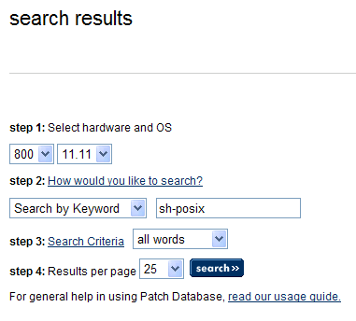
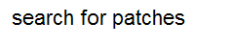
Downloading Patches from HPSC 1 of 4
http://h20566.www2.hp.com/portal/site/hpsc/public/
Enter your OS
version here
Enter a search
string here
Specify a search
type here
Click [Search]
45

Slide 46
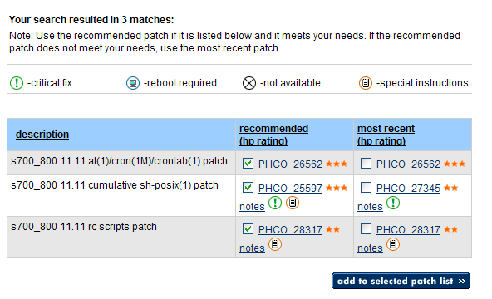
Downloading Patches from HPSC 2 of 4
Note the patch
ratings
Click a patch name to
read the .text file
Select desired patches
Click add to selected
patch list
46

Slide 47
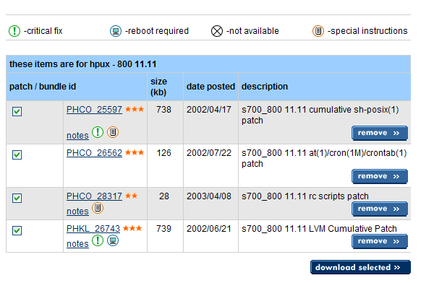
Downloading Patches from HPSC 3 of 4
Click download
selected
47

Slide 48
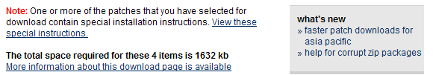
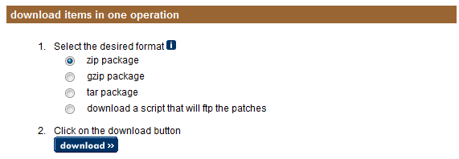
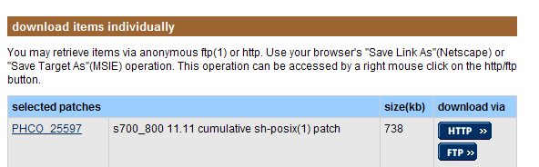
Downloading patches from HPSC 4 of 4
Review special
instructions
Choose a
download format
Click download
Or, download
individual patches
48

Slide 49
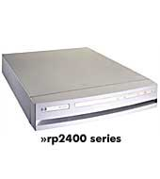
Installing Single Patch from HPSC
gzip archive
Do a full backup
Unzip the archive:
# gzip -d /tmp/patches.tgz
Untar the archive:
# tar -xvf /tmp/patches.tar
Unshar each patch:
# sh /tmp/PHCO_10000
Read the resulting .text file carefully:
# more /tmp/PHCO_10000.text
Preview the installation
# swinstall –p \
–s /tmp/PHCO_10000.depot \
-x autoreboot=true \
-x patch_match_target=true
Install the patch:
# swinstall –s /tmp/PHCO_10000.depot \
-x autoreboot=true \
-x patch_match_target=true
tar archive
shar archive
PHCO_10000.text
PHCO_10000.depot

Slide 50
Installing Multiple Patches from HPSC
PHCO_10000
Do a full backup
Unzip the archive:
# gzip -d /tmp/patches.tgz
Untar the archive:
# tar -xvf /tmp/patches.tar
Copy the patches to a depot:
# cd /tmp
# ./create_depot_hp-ux_11
Check for dependencies and special instructions
# swlist –a readme –s /tmp/depot | more
Preview the installation:
# swinstall –p \
–s /tmp/depot \
-x autoreboot=true \
-x patch_match_target=true
Install all of the patches from the depot:
# swinstall –s /tmp/depot \
-x autoreboot=true \
-x patch_match_target=true
PHCO_21345
PHCO_31104
Depot
PHCO_10000
PHCO_21345
PHCO_31104

Slide 51

Installing HP-UX Patches from DVD
Do a full backup
Read the Read-Before-Installing documentation that came with the DVD
(if any)
# ioscan –funC disk
# mkdir /dvd
# mount –o ro,rr,cdcase /dev/disk/diskx /dvd
# ls /dvd
# swlist –a readme –s /dvd | more
# swinstall –p \
-s /dvd \
-x autoreboot=true \
-x patch_match_target=true
# swinstall -s /dvd \
-x autoreboot=true \
-x patch_match_target=true
HP-UX install media

Slide 52
HP-UX Ignite-UX Depots from ISO
After the installation of the ISOIMAGE-ENH bundle on HP-UX 11iv3, the module fspd needs to be loaded (DLKM module) to enable the NCF.
To load the module
# kcmodule fspd=loaded
Create Ignite-UX depot
# mount /tmp/5014-1445.iso /dvd
# make_depots -v -x mount_all_filesystems=false -r B.11.31 \
-s /dvd
# make_config -c /var/opt/ignite/data/Rel_B.11.31/core_cfg \
-s svr:/var/opt/ignite/depots/Rel_B.11.31/core
# manage_index -a -f /var/opt/ignite/data/Rel_B.11.31/core_cfg -c "HP-UX B.11.31 Default"

Slide 53
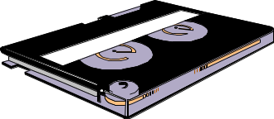
Installing HP-UX Patches from Tape
Do a full backup
Check for dependencies and special instructions:
# swlist –a readme –s /dev/rtape/tape0_BEST
Preview the installation
# swinstall –p \
-s /dev/rtape/tape0_BEST \
-x autoreboot=true \
-x patch_match_target=true
Install the patches
# swinstall -s /dev/rtape/tape0_BEST \
-x autoreboot=true \
-x patch_match_target=true
Depot Format
Patch Tape

Slide 54
Installing HP-UX Patches from Depot Server
Do a full backup
Check for dependencies and special instructions:
# swlist –a readme –s svrname:/depotpath
Preview the installation
# swinstall –p \
-s svrname:/depotpath \
-x autoreboot=true \
-x patch_match_target=true
Install the patches
# swinstall -s svrname:/depotpath \
-x autoreboot=true \
-x patch_match_target=true
SD-UX Depot
Server

Slide 55
HP-UX Patches by Name or Category Tag
The previous examples used patch_match_target to select patches from a depot.
Alternatively, use the options below to explicitly select specific patches.
In all of these examples, the default –x autoselect_dependencies=true option automatically selects all patches required to meet dependencies, too.
Automatically select all patches from the source depot that match existing installed software
# swinstall –s depot –x autoreboot=true -x patch_match_target=true
Install a specific patch from a depot
# swinstall –s depot –x autoreboot=true PHCO_1000 PHCO_2000
Install a patch bundle (installs the patches from the bundle that match installed software)
# swinstall –s depot –x autoreboot=true QPKBASE11i
Install all patches that have the “critical” category tag
# swinstall –s depot –x autoreboot=true ″*,c=critical″
Manually select patches and bundles via the GUI/CLI interface
# swinstall –s depot -i
55

Slide 56
Verifying HP-UX Patch Installation
Review the install log messages via the swjob command reported by swinstall
# swjob -a log target-0037 @ target:/
Review system startup messages if the patch caused a reboot
# view /etc/rc.log
Verify the patch via swverify , then view the detailed swverify log via swjob
# swverify PHCO_10000
# swjob -a log target-0038 @ target:/
Ensure that for all patches, patch_state=applied and state=configured
# swlist –a patch_state –a state ″PH*″
# PHCO_10000
PHCO_10000.FOOPROD applied configured
Compare file checksums and versions to checksums and versions in the patch README
# swlist –s depot –a readme PHCO_10000
# cksum /usr/bin/foo
# what /usr/bin/foo
56
Notes:
[Course Title]
[Module Title]
[Rev. # or date] – © 2008 Hewlett-Packard Development Company, L.P.

Slide 57
Listing HP-UX Patches
Use the swlist –l patch command to list patches installed on system.
Add –x show_superseded_patches=true to include superseded patches.
List all applied patches
# swlist –l patch
# PHKL_39129 1.0 vxfs cumulative patch
PHKL_39129.VXFS-BASE-KRN 1.0 JFS.VXFS-BASE-KRN
# PHKL_39170 1.0 io cumulative patch
PHKL_39170.CORE2-KRN 1.0 OS-Core.CORE2-KRN applied
List a specific applied patch
# swlist –l patch PHKL_39129
# PHKL_39129 1.0 vxfs cumulative patch
PHKL_39129.VXFS-BASE-KRN 1.0 JFS.VXFS-BASE-KRN applied
List all patches applied to a specific product
# swlist -l patch JFS
# JFS B.11.31 Base VxFS File System
# JFS.VXFS-BASE-KRN B.11.31 The Base VxFS Kernel
PHKL_39129.VXFS-BASE-KRN 1.0 JFS.VXFS-BASE-KRN applied
# JFS.VXFS-BASE-RUN B.11.31 Utilities for VxFS
PHCO_37394.VXFS-BASE-RUN 1.0 JFS.VXFS-BASE-RUN applied
PHCO_37807.VXFS-BASE-RUN 1.0 JFS.VXFS-BASE-RUN applied
57

Slide 58
Removing HP-UX Patches - Concepts
SD-UX maintains backup copies of files replaced by patches
Removing a patch removes the patched files, and restores the associated pre-patch files
# swremove –x autoreboot=true PHCO_10000
Installing a patch automatically copies the pre-patched files to /var/adm/sw/save
/usr/bin/foo
/var/adm/sw/save/PHCO_10000/FOO-RUN
/var/adm/sw/save/PHCO_10000/FOO-RUN/usr
/var/adm/sw/save/PHCO_10000/FOO-RUN/usr
/var/adm/sw/save/PHCO_10000/FOO-RUN/usr/bin
/var/adm/sw/save/PHCO_10000/FOO-RUN/usr/bin/foo
(patched)
(original)
Removing a patch automatically restores the pre-patched files in the file system
/usr/bin/foo
/var/adm/sw/save/PHCO_10000/FOO-RUN
/var/adm/sw/save/PHCO_10000/FOO-RUN/usr
/var/adm/sw/save/PHCO_10000/FOO-RUN/usr
/var/adm/sw/save/PHCO_10000/FOO-RUN/usr/bin
/var/adm/sw/save/PHCO_10000/FOO-RUN/usr/bin/foo
(original)
(patched)
58

Slide 59
Removing HP-UX Patches - Commands
Use swremove to remove a patch.
swremove automatically restores the associated pre-patch files.
Do a full backup
Check for dependencies and special instructions in the patch readme file:
# swlist –a readme PHCO_10000
Preview the removal
# swremove –p -x autoreboot=true PHCO_10000
Remove the patch
# swremove -x autoreboot=true PHCO_10000
Verify that the patch was removed and that the previous patch was restored
# swlist –l patch FooProd
swremove fails if removing the patch would break dependencies.
When removing patches in a supersession chain, remove the last patch first.
Removing a product automatically removes the product’s patches too.
There is no command for automated rollback of patch bundles.

Slide 60
Committing HP-UX Patches - Concepts
The /var/adm/sw/save/ directory may consume significant disk space.
Committing a patch reclaims that disk space, but…
You can never remove a committed patch unless you remove the patch’s product.
HP discourages committing patches.
Before committing a patch, /var/adm/sw/save contains a copy of all pre-patched files
# find /var/adm/sw/save/PHCO_10000/
/var/adm/sw/save
/var/adm/sw/save/PHCO_10000/FOO-RUN
/var/adm/sw/save/PHCO_10000/FOO-RUN/usr
/var/adm/sw/save/PHCO_10000/FOO-RUN/usr
/var/adm/sw/save/PHCO_10000/FOO-RUN/usr/bin
/var/adm/sw/save/PHCO_10000/FOO-RUN/usr/bin/foo
After committing a patch, the backup no longer exist
# find /var/adm/sw/save/PHCO_10000/
find: cannot stat /var/adm/sw/save/PHCO_10000/
Attempt to remove the patch fails
# swremove PHCO_1000
ERROR: Cannot continue the "swremove" task.
60
Notes:
# swremove PHSS_39122
======= 09/09/09 12:13:48 EDT BEGIN swremove SESSION
(non-interactive) (jobid=rx16u831-0039)
* Session started for user "root@rx16u831".
* Beginning Selection
* Target connection succeeded for "rx16u831:/".
NOTE: One or more patch filesets were automatically selected or
deselected to maintain patch integrity. Please refer to the
swremove.log logfile for details.
ERROR: Cannot continue the "swremove" task.
* Selection had errors.
======= 09/09/09 12:13:49 EDT END swremove SESSION (non-interactive)
(jobid=rx16u831-0039)
[Course Title]
[Module Title]
[Rev. # or date] – © 2008 Hewlett-Packard Development Company, L.P.

Slide 61
Committing HP-UX Patches - Commands
You can commit patches during OS installation, patch installation, or
anytime thereafter.
Commit an already-installed patch
# swmodify –x patch_commit=true PHCO_10000
Commit a patch at the same time you install the patch
# swinstall –s /depot –x patch_save_files=false PHCO_10000
Commit patches at the same time you install the OS
Ignite → Basic → [Additional]
Save patched files?... [NO]
Preview, then commit, all existing patches that have been superseded at least three times
# cleanup –p –c 3
# cleanup –c 3
Verify patch_state
# swlist –l patch PHCO_10000
# PHCO_10000 1.0 FooProd Patch
# PHCO_10000.FOO-RUN 1.0 FooProd.FOO-RUN committed
61
Notes:
[Course Title]
[Module Title]
[Rev. # or date] – © 2008 Hewlett-Packard Development Company, L.P.

Slide 62
HP-UX Patch Management with SD-UX Depots

Slide 63
SD-UX Depot
SD-UX Depot is a repository for software bundled using HP Software Distributor utilities and tools.
Depots may be stored on CD-ROM, DVD, tape, in a .depot file, or in a directory on disk.
Software from install CDs
Patches from HPSC
PHCO_10000.depot
Software from http://software.hp.com
SwAssistant.depot
Patch Tapes
Depot
63
Notes:
[Course Title]
[Module Title]
[Rev. # or date] – © 2008 Hewlett-Packard Development Company, L.P.

Slide 64
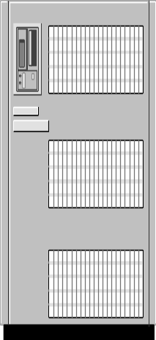
SD-UX Depot Server
SD-UX Depot Server is an HP-UX host that has one or more registered
depot directories from which clients can install software.
Data Center OE depot
Application depot
Internet Express depot
Depot server
Target clients
64
Notes:
[Course Title]
[Module Title]
[Rev. # or date] – © 2008 Hewlett-Packard Development Company, L.P.

Slide 65
SD-UX Server
By configuring an SD-UX depot server, YOU…
Do not have to deal with stacks of tapes and DVDs.
Can manage software from a single, central location.
Can ensure consistent software and patch loads.
Can push and pull software remotely across the network.
Can install multiple kernel patches with a single reboot.
swinstall automatically manages dependencies.
swinstall automatically installs patches at product install time.

Slide 66
Planning for SD-UX Depots
Where should I put my software depot?
Consider available disk space,
Consider network connectivity,
Will you create one depot on your server…or several?
  Create a separate depot for each O/S version;
  Create separate depots for the O/S vs. Applications;
  Store products and their patches in the same depot.
66

Slide 67
Copying Software and Patches to SD-UX Depot
Use the swcopy command to copy software and patches from depot to depot.
If a patch has dependencies, swcopy copies the dependents from the source
(add –x autoselect_dependents=false to disable dependent auto-selection).
If a patch dependencies cannot be satisfied, swcopy fails (add –x enforce_dependencies=false to disable dependency enforcement).
Copy software and patches from a DVD depot to a directory depot
# swcopy –x enforce_dependencies=false –s /dvd \* @ /mydep
Copy a patch from depot file to a directory depot
# swcopy –x enforce_dependencies=false \
–s /tmp/PHCO_10000.depot \* @ /mydep
Copy software and patches from one directory depot to another directory depot
# swcopy –x enforce_dependencies=false –s /myolddepot \* @ /mydep
Copy software and patches from a tape depot to a directory depot
# swcopy –x enforce_dependencies=false \
–s /dev/rtape/tape0_BEST \* @ /mydep
67

Slide 68
Removing Patches from SD-UX Depot
Remove a single patch or product from a depot
svr# swremove –d PHCO_10000 @ /mydepot
Remove all patches and products from the depot, and the depot itself
svr# swremove –d \* @ /mydepot
svr# rm /mydepot/swagent.log
svr# rmdir /mydepot
Two swremove options determine what happens if the patch you wish to remove is
required to meet dependencies for other patches and products in the depot:
-x enforce_dependencies | -x autoselect_dependents | result
true | false | nothing removed (default)
false | false | patch removed, dependents remain
true | true | patch and dependents removed
68

Slide 69
Removing Superseded Patches from SD-UX Depot
Patches from HP are typically cumulative.
Later patches may supersede older patches.
You can use the cleanup command to purge superseded patches from depot.
Verify that the cleanup command exists on your system
# whereis cleanup
Preview the list of superseded patches in the depot
# cleanup –p –d /mydepot
Purge the superseded patches from the depot
# cleanup –d /mydepot
PHCO_10000
PHCO_100246
PHCO_20118
superseded by…
superseded by…
69

Slide 70
Verifying SD-UX Depot
After adding and removing software and patches in a depot, consider
executing swverify to ensure that the depot meets all patch
dependencies .
Verify that a depot is not missing dependencies
# swverify -d \* @ /mydepot
======= 02/03/12 11:24:46 EDT BEGIN swverify SESSION
(non-interactive)(jobid=svr-0015)
* Session started for user "root@svr".
…
* Verification succeeded.
NOTE: More information may be found in the agent logfile
using the command "swjob -a log svr-0015 @
svr:/mydepot".
======= 02/03/12 11:24:46 EDT END swverify SESSION
(non-interactive)(jobid=svr-0015)
View the detailed swverify log messages
# swjob -a log svr-0015 @ svr:/mydepot
70
Notes:
[Course Title]
[Module Title]
[Rev. # or date] – © 2008 Hewlett-Packard Development Company, L.P.

Slide 71
Listing SD-UX Depot Contents
List available depots on remote server sanfran
# swlist –l depot @ sanfran
# Initializing...
# tgt “sanfran" has the following depot(s):
/mydepot
/myappdepot
List software and patches in a depot /mydepot on remote server sanfran
# swlist –l patch -s sanfran:/mydepot
# tgt: sanfran:/mydepot
# Bundle(s):
FooProd A.01.01 My product
71

Slide 72
Pulling Software from SD-UX Depot
Once the depot server has been configured, any host on the network
can “pull” software from the depot server via the swinstall command.
tgt# swinstall –s svr:/mydepot \
-x autoreboot=true FooProd
software pull
svr
tgt host
72

Slide 73
Pushing Software From SD-UX Depot - Concept
Using the 11i swinstall “push” functionality allows you to push software installs/updates from the depot server out to one or more remote target hosts simultaneously.
Additional configuration is required on both the client and server to allow a server to push software to a client.
tgt1
software
push
tgt2
tgt3
svr
73

Slide 74
Security Risk – Ignite-UX Push Prevention
Client systems may block the use of the bootsys command through existence of the /.bootsys_block file.
This file may either be empty, contain the word confirm, and/or it may contain a message that explains why the client is blocking bootsys. If the file is empty, bootsys refuses to execute on the target. If the first line of the file contains the word confirm, the user running bootsys on the Ignite-UX server is asked if client installation should continue. If the file contains any other text, that text is displayed to the console when the bootsys command was executed. Typically this text is used to explain why the client is blocking any bootsys attempts.
This is a common security risk that many customers forget to address.
Simplest method to block remote Ignite-UX server:
# touch /.bootsys_block
74

Slide 75
Pushing Software from SD-UX Depot - Commands
Use the setaccess command on each target host to enable access from the depot server.
Beware that SD-UX uses simple user/host-based authentication to authenticate network SD-UX requests.
Configure push functionality on the depot server
svr# touch /var/adm/sw/.sdkey
Allow the depot server to push software to a client (repeat on each client)
tgt# /usr/lbin/sw/setaccess svr
tgt# swacl –l root
Use the push functionality to remotely install, list, and remove software
svr# swinstall –s svr:/mydepot FooProd @ tgt1 tgt2 tgt3
svr# swlist @ tgt1 tgt2 tgt3
svr# swremove FooProd @ tgt1 tgt2 tgt3
75

Slide 76
Registering and Unregistering SD-UX Depots
Register a depot
# swreg –l depot @ /cdrom
# swlist –l depot
# Initializing...
# tgt “sanfran" has the following depot(s):
/cdrom
Unregister a depot
# swreg –ul depot @ /cdrom
# swlist –l depot
# Initializing...
# WARNING: No depot was found for "sanfran:".
76

Slide 77
Creating Custom Patch Bundle
Consider creating a custom patch reference bundle wrapper in your depots.
Update the bundle wrapper’s revision number when you add update the depot.
Installing any patch from the bundle automatically installs the bundle wrapper.
Use the bundle wrapper revision to determine when a host was last patched.
Create or update a patch reference bundle wrapper on the depot server
svr# make_bundles –i \
-B \
-n MyPatchBundle \
-t "My Patch Bundle" \
-r A.01.00 \
'PH*' @ /mydepot
Install patches from the depot server (automatically installs the wrapper)
tgt# swinstall –s svr –x patch_match_target=true \
-x autoreboot=true
Determine when target was last patched
tgt# swlist MyPatchBundle
MyPatchBundle A.01.00 My Patch Bundle
77

Slide 78
Creating Custom .depot File
Creating a .depot file from a directory depot makes it possible to easily copy or
email a depot and its contents to a remote system when firewalls or connectivity
issues prevent direct swinstall access to the depot server.
Create the depot file
svr# swpackage –s /mydepot \
–x media_type=tape \
\* @ /tmp/mydepot.depot
Verify the depot file
svr# swlist –s /tmp/mydepot.depot
PHCO_1000
PHCO_2000
PHCO_3000
PHCO_1000
PHCO_2000
PHCO_3000
/mydepot
/tmp/mydepot.depot
78

Slide 79
Creating Custom Patch Tape
If you need to install patches on remote systems that have little or no
connectivity to the directory depot server, create a custom depot tape.
Create the tape depot
svr# swpackage –s /mydepot \
–x media_type=tape \
\* @ /dev/rtape/tape0_BEST
Verify the tape depot
svr# swlist –s /dev/rtape/tape0_BEST
PHCO_10011
PHCO_20346
PHCO_31077
PHCO_10011
PHCO_20346
PHCO_31077
/mydepot
/dev/rtape/tape0_BEST
79

Slide 80
Creating Custom Patch CD-ROM/DVD
If you need to install patches on remote systems that have little or no connectivity to
the directory depot server, and a tape drive isn’t available, create patch CD-ROM.
Create the CDROM
svr# swlist IGNITE
svr# /opt/ignite/lbin/mkisofs –R -o /tmp/mycd.iso /mydepot
Verify the ISO file
svr# swlist ISOIMAGE-ENH
svr# kcmodule fspd=loaded cdfs=loaded
svr# mkdir –p /mnt/cd
svr# mount –F cdfs –o rr,cdcase /tmp/mycd.iso /mnt/cd
svr# swlist –s /mnt/cd
Transfer the ISO file to a PC and burn it to a DVD
PHCO_10011
PHCO_20346
PHCO_31077
PHCO_10011
PHCO_20346
PHCO_31077
/mydepot
80
Notes:
Verify the depot
svr# swlist ISOIMAGE-ENH
svr# kcmodule fspd=loaded cdfs=loaded
svr# mount –F cdfs –o rr,cdcase /tmp/mycd.iso /mnt/cd
svr# swlist –s /mnt/cd
The different answers are interesting to read. What follows is the way I create CD's that can be mounted on HP-UX.
I write my CD's with NERO-Burning Rom ( http://www.nero.com ) on an NT4 pc.
I transfer the software-depots and the files with BINARY-format FTP from my UNIX to the local harddisk of the PC.
I use the following settings
File-/Directorynames length : "ISO Level 2 (Max of 31 chars)"
Format : "Mode 1"
Character Set : "ISO 9660"
Relax ISO Restrictions : ( ! important !)
X : Allow pathdepth of more than 8 directories
X : Allow more than 255 characters in path
I hope this helps, (in case you aren't already creating cd's with the other solution mentioned).
# lvcreate -L 600 -n tmpdepot vg01
# newfs -F hfs -f 2048 /dev/vg01/rtmpdepot
# mkdir /tmpdepot
# mount /dev/vg01/tmpdepot /tmpdepot
# swcopy –s /depot \* @ /tmpdepot
# umount /tmpdepot
# dd if=/dev/vg01/rtmpdepot of=/tmp/tmpdepot.hfs bs=1024k
# cdrecord –v speed=2 dev=0,0 /tmp/tmpdepot.hfs (Linux!)
# mount -F hfs -o ro /dev/dsk/cxtxdx /cd
# swinstall –s /cd –x autoreboot=true \*
[Course Title]
[Module Title]
[Rev. # or date] – © 2008 Hewlett-Packard Development Company, L.P.

Slide 81
HP-UX Patch Management with Software Assistant (SWA)

Slide 82
Software Assistant Overview
Use SWA utility to identify necessary security patches.
SWA is an enhanced, more comprehensive successor to Security Patch Check.
SWA is supported on 11i v1, v2 and v3, BUT does not include Independent Software Units (ISUs).
HP-UX swa utility can automatically:
Download a patch catalog from the HPSC,
Generate a variety of reports that:
  Identify “warning” patches that should be removed from a host/depot
  Identify recommended security patches and QPK patch bundles
  Identify vulnerable products that should be updated in a host/depot
  Identify vulnerable products that should be removed from a host/depot
  Identify manual steps that may be required to avoid critical vulnerabilities
Download recommended patches to a local depot.
Notes:
[Course Title]
[Module Title]
[Rev. # or date] – HP Restricted

Slide 83
Installing SWA
Check prerequisites listed in the SWA Administrator’s guide.
Download and install B6834AA if it is not already installed
# swinstall –s /root/swa.depot SwAssistant
Add the new utility’s path to your PATH variable
# vi ~/.profile
PATH=$PATH:/opt/swa/bin/
# . ~/.profile
Notes:
[Course Title]
[Module Title]
[Rev. # or date] – HP Restricted

Slide 84
One-Minute SWA Cookbook 1 of 3
Copy or rename the SWA template file
# cd /etc/opt/swa
# cp swa.conf.template swa.conf
The lines recommended to change
# awk '! /^#|^$/ { print}' swa.conf
analyzers = QPK SEC PCW CRIT
ftp_proxy = ${proxy}
hp_id = HPSClogin
hp_pw = HPSCpasswd
https_proxy = ${proxy}
http_proxy = ${proxy}
proxy=http://proxylogin:proxypasswd@proxyid:proxyport
Notes:
[Course Title]
[Module Title]
[Rev. # or date] – HP Restricted

Slide 85
One-Minute SWA Cookbook 2 of 3
... where:
HPSClogin is valid HPSC (HP Passport) login name
HPSCpasswd is valid HPSC (HP Passport) password
proxylogin is Web proxy login
proxypasswd is Web proxy password
proxyid is Web hostname (or IP address)
proxyport is Web proxy port
Notes:
[Course Title]
[Module Title]
[Rev. # or date] – HP Restricted

Slide 86
One-Minute SWA Cookbook 3 of 3
If, by any chance, the proxy server requires Windows Active Directory domain authentication too, change the line in swa.conf to:
proxy=http://"windomain\proxylogin:proxypasswd"@proxyid:proxyport
Notes:
[Course Title]
[Module Title]
[Rev. # or date] – HP Restricted

Slide 87
Generating SWA Reports
Download the latest catalog and evaluate the localhost
# swa report -x inventory_max_age=0 -x catalog_max_age=0
Download the latest catalog and evaluate a remote host
# swa report -x inventory_max_age=0 -x catalog_max_age=0 \
-s ssh://user@remotesystem
Download the latest catalog and evaluate a depot
# swa report -x inventory_max_age=0 -x catalog_max_age=0 \
-s ssh://user@remotesystem/depotpath
Use a manually downloaded catalog to evaluate the localhost
# swa report -x inventory_max_age=0 –x \
catalog=~/swa_catalog.xml.gz -x catalog_max_age=-1
87
Notes:
[Course Title]
[Module Title]
[Rev. # or date] – HP Restricted
# swa report -x analyzers="SEC"
======= 10/29/07 12:29:29 EDT BEGIN Report on Issues and New Software
(user=root) (jobid=rp24u181)
* Gathering Inventory
* Using existing inventory for host "rp24u181"
* Getting Catalog of Recommended Actions and Software
* Using existing local catalog file
* Performing Analysis
* Generating Reports
NOTE: See HTML-formatted report "/root/.swa/report/swa_report.html"
Software Assistant
Actions Summary Report
ASSESSMENT PROFILE
Catalog Information
Catalog File: /root/.swa/cache/swa_catalog.xml
Catalog Date: 29 October 2007 09:06:46 EST
Inventory Source
Name: rp24u181
OS: HP-UX B.11.23
Model: 9000/800/A400-6X
Inventory File: /root/.swa/cache/swa_inventory_3663373087.xml
Inventory Date: 29 October 2007 09:43:01 EST
Analysis Information
Analysis File: /root/.swa/cache/swa_analysis.xml
Analysis Date: 29 October 2007 11:29:56 EST
Ignore File(s): /root/.swa/ignore
Issues Ignored: 0
Selected Analyzers
SEC: security bulletins
RECOMMENDED ACTIONS
Patch Bundles
The following bundles are recommended by HP. The patches delivered in these
patch bundles may include fixes for patches not listed in this report. If
you will not install the patch bundle(s) listed here, please re-run the
analysis without the "QPK" analyzer and generate a new report to obtain
a full list of patches.
Bundle Revision Description
------ -------- -----------
Patches
See detail or html report for more links to patch details such as
special installation instructions, patch quality rating, patch reboot,
and other dependencies.
Patch ID Date Description
-------- ---- -----------
PHCO_31607 2004-09-22 authck(1M) cumulative patch
PHCO_31616 2004-09-22 passwd(1) cumulative patch
PHCO_31618 2004-09-22 libpam_updbe cumulative patch
PHCO_31621 2004-09-22 libpsm cumulative patch
PHCO_31625 2004-09-22 Japanese INET manpages
PHCO_32146 2005-06-10 libpam cumulative patch
PHCO_32444 2005-10-10 sh-posix(1) cumulative patch
PHCO_32475 2005-06-27 ps(1) cumulative patch
PHCO_33487 2005-10-31 libpam_hpsec cumulative patch
PHCO_34151 2006-04-11 mkdir(1) cumulative patch
PHCO_34764 2006-07-18 ugm cumulative patch
PHCO_35048 2006-12-11 libsec cumulative patch
PHCO_35251 2007-01-03 libpam_unix cumulative patch
PHCO_35524 2007-04-06 LVM commands patch
PHCO_36808 2007-09-11 logins(1M) cumulative patch
PHKL_31500 2004-09-22 Sept04 base patch
PHKL_34194 2006-01-30 POSIX real-time message queue update
PHKL_36244 2007-04-16 LVM Cumulative Patch
PHNE_33508 2006-06-30 slpd(1M) patch
PHNE_34107 2006-12-04 Mail agents/utilities cumulative patch
PHNE_34150 2006-10-18 r-commands cumulative mega-patch
PHNE_34698 2006-11-15 ftpd(1M) and ftp(1) patch
PHNE_34788 2007-05-31 Cumulative STREAMS Patch
PHNE_35485 2006-12-21 sendmail(1M) 8.11.1 patch
PHNE_35545 2007-05-07 LAN cumulative patch
PHNE_35766 2007-07-24 cumulative ARPA Transport patch
PHNE_35770 2007-06-01 telnet kernel, telnetd(1M), telnet(1) patch
PHNE_36973 2007-09-04 Bind 9.2.0 components
PHSS_34159 2006-02-23 XClients Patch
PHSS_34991 2007-05-08 KRB5-Client Version 1.0 Cumulative patch
PHSS_35046 2006-10-03 X/Motif Runtime Patch
PHSS_35884 2007-02-27 CDE Base Patch
PHSS_35885 2007-02-27 CDE Applications Patch
PHSS_36452 2007-05-31 Xserver cumulative patch
Manual Actions
See detail or html report for more information on each action.
The following Detection Confidence (DC) levels are used:
D - Detection confidence is "definite" and based on specific revisions
of installed software.
R - Detection confidence is "relevant" and based on installed software
but can not determine if action has been taken.
U - Detection confidence is "unknown" and based only on operating
system version.
Issue DC Date Description
----- -- ---- -----------
02074r2 D 2006-03-15 For hpuxwsAPACHE, install revision B.2.0.58.01 or
subsequent
02090r2 D 2006-06-05 For Secure_Shell, install revision A.04.40.007 or
subsequent
02114r1 D 2006-05-22 For SW-DIST, install revision B.11.23.0612 or
subsequent
02115r2 D 2006-08-15 For Sup-Tool-Mgr, install revision B.11.23.07.04 or
subsequent
02122r2 D 2006-06-28 For Mozilla, install revision 1.7.13 or subsequent
02155r2 D 2006-09-25 For CIFS-Server, install revision A.02.03.02 or
subsequent
02174r2 D 2006-12-18 For openssl, install revision A.00.09.07l.007 or
subsequent
02196r2 D 2007-03-09 For Jdk14, install revision 1.4.2.12.00 or
subsequent
02196r2 D 2007-03-09 For Jpi14, install revision 1.4.2.12.00 or
subsequent
02196r2 D 2007-03-09 For Jre14, install revision 1.4.2.12.00 or
subsequent
02196r2 D 2007-03-09 For Jdk15, install revision 1.5.0.06 or subsequent
02196r2 D 2007-03-09 For Jre15, install revision 1.5.0.06 or subsequent
02235r1 D 2007-08-07 For HPOvLcore, install revision
XPL_COMPONENT_3.10.040 or subsequent
02249r2 D 2007-09-12 For Ignite-UX, use the script from the Resolution
to work around the vulnerability
00150 R 2001-05-09 For SW-DIST, check swacl settings
00298 R 2007-03-29 For IPF-HP, the supported interfaces are documented
below.
00298 R 2007-03-29 For PFIL-HP, the supported interfaces are
documented below.
01133r3 R 2007-03-15 For Mozilla, work around CAN-2005-2781
01164r9 R 2006-01-17 For Networking, optionally set ip_pmtu_strategy=0
01219r1 R 2007-04-26 For Ignite-UX, change permissions, remove files
02145r2 R 2006-12-04 For hpuxwsAPACHE, restart Apache
02186r1 R 2007-01-23 For hpuxwsAPACHE, restart Apache
02203r1 R 2007-04-09 For OS-Core, discontinue use of PFS.
02203r1 R 2007-04-09 For ProgSupport, discontinue use of PFS.
02242r2 R 2007-08-16 For HPOvLcore, as discussed in the Resolution
section
01099 U 2007-03-22 Verify download integrity with md5 sums.
01138 U 2007-04-26 Install RADINFRAHPUX1_00003
01143 U 2007-04-26 Install RADAPPSHPUX1_00001
01143 U 2007-04-26 Install RADAPPSHPUX1_00002
02133r6 U 2007-07-18 If Oracle for OpenView (OfO) is installed, install
the Oracle Critical Patch Update - October 2007
02279r1 U Install RADINFRAHPUX1_00009 or subsequent
02279r1 U Install RADINFRAHPUX1_00010 or subsequent
02279r1 U Install RADINFRASOL_00011 or subsequent
SEE ALSO
swa "issue", "detail", and "html" reports, swa-report(1m).
======= 10/29/07 12:30:15 EDT END Report on Issues and New Software
succeeded. (user=root) (jobid=rp24u181)
NOTE: More information may be found in the Software Assistant logfile
"/var/opt/swa/swa.log".

Slide 88
Selecting SWA Analyzers
Determine if host is missing the latest quality pack patch bundle
# swa report –x analyzers=″QPK″ …
Determine if host has any patches with critical warnings
# swa report –x analyzers=″PCW″ …
Determine if host has any patches with any warnings, critical or otherwise
# swa report –x analyzers=″PW″ …
Determine if host is missing any critical patches
# swa report –x analyzers=″CRIT″ …
Determine if host has any filesets with associated security bulletins
# swa report –x analyzers=″SEC″ …
Determine if host has neither the specified nor a superseding patch
# swa report –x analyzers=″CHAIN=PHCO_10000,PHCO_20012″ …
If you don’t specify otherwise, SWA uses:
# swa report –x analyzers=″QPK SEC PCW″ …
SWA always invokes the AUTO analyzer to search for missing patch dependencies.
88

Slide 89
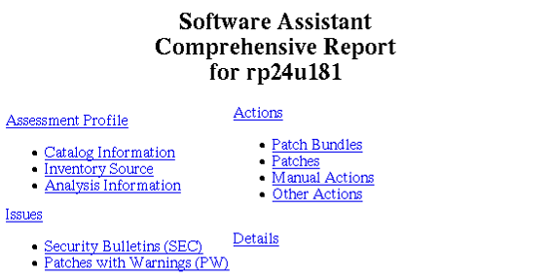
Viewing SWA Report
With Web Browser
# firefox ~/.swa/report/swa_report.html &
Command-line.
89
Notes:
[Course Title]
[Module Title]
[Rev. # or date] – HP Restricted

Slide 90
Retrieving SWA Recommended Patches
Use swa get to retrieve the patches recommended in the last SWA report.
Patches can be copied to a user-specified new or existing depot.
swa only downloads patches, no product or application updates.
swa doesn’t download patches that are already in the target depot.
swa validates all downloaded files via md5 checksums.
Preview the download
# swa get -p –t /var/tmp/mydepot
Download the patches
# swa get –t /var/tmp/mydepot
Other helpful options:
[-x allow_existing_depot=false]
[-x swcache=/var/opt/swa/cache/]
[-x user_dir=~/.swa
Notes:
[Course Title]
[Module Title]
[Rev. # or date] – HP Restricted
# swa get -p -t /var/tmp/swa.depot -x allow_existing_depot=true -x swcache=…
======= 10/29/07 13:24:26 EDT BEGIN Get New Software From HP Preview
(user=root) (jobid=rp24u181)
* Analyzing Required Disk Space
* System Information
Name: rp24u181
OS: HP-UX 11.23
Model: 9000/800/A400-6X
Inventory File: /root/.swa/cache/swa_inventory_3663373087.xml
Inventory Date: 29 October 2007 09:43:01 EST
* Analysis Information
Analysis File: /root/.swa/cache/swa_analysis.xml
Analysis Date: 29 October 2007 12:00:47 EST
Catalog: /root/.swa/cache/swa_catalog.xml
Catalog Date: 29 October 2007 09:06:46 EST
Ignore File: /root/.swa/ignore
* Selected Analyzers
SEC - security bulletins
* Software Cache
/var/opt/swa/cache
* Target Depot
/var/tmp/swa.depot
* No software needs to be copied into the target depot
======= 10/29/07 13:24:28 EDT END Get New Software From HP Preview succeeded.
(user=root) (jobid=rp24u181)
NOTE: More information may be found in the Software Assistant logfile
"/var/opt/swa/swa.log".
# swa get -t /var/tmp/swa.depot
======= 10/29/07 13:01:58 EDT BEGIN Get New Software From HP (user=root)
(jobid=rp24u181)
* Analyzing Required Disk Space
* System Information
Name: rp24u181
OS: HP-UX 11.23
Model: 9000/800/A400-6X
Inventory File: /root/.swa/cache/swa_inventory_3663373087.xml
Inventory Date: 29 October 2007 09:43:01 EST
* Analysis Information
Analysis File: /root/.swa/cache/swa_analysis.xml
Analysis Date: 29 October 2007 12:00:47 EST
Catalog: /root/.swa/cache/swa_catalog.xml
Catalog Date: 29 October 2007 09:06:46 EST
Ignore File: /root/.swa/ignore
* Selected Analyzers
SEC - security bulletins
* Software Cache
/var/opt/swa/cache
* Target Depot
/var/tmp/swa.depot
* Downloading Software from HP to Local Cache
NOTE: Estimated total download size: 250064234 bytes.
* Downloading PHCO_32475 (1 of 34)
* Download complete: 181kB
* Downloading PHCO_34151 (2 of 34)
* Download complete: 542kB
* Downloading PHNE_35770 (3 of 34)
* Download complete: 649kB
* Downloading PHNE_34150 (4 of 34)
* Download complete: 1018kB
* Downloading PHKL_34194 (5 of 34)
* Download complete: 65kB
* Downloading PHSS_35884 (6 of 34)
* Download complete: 5447kB
* Downloading PHCO_31618 (7 of 34)
* Download complete: 152kB
* Downloading PHNE_34107 (8 of 34)
* Download complete: 3593kB
* Downloading PHNE_35485 (9 of 34)
* Download complete: 4580kB
* Downloading PHSS_34991 (10 of 34)
* Download complete: 4685kB
* Downloading PHNE_36973 (11 of 34)
* Download: 6412kB (22% complete)
* Download: 13714kB (47% complete)
* Download: 21098kB (73% complete)
* Download: 28381kB (98% complete)
* Download complete: 28086kB
* Downloading PHCO_34764 (12 of 34)
* Download complete: 620kB
* Downloading PHCO_31625 (13 of 34)
* Download complete: 348kB
* Downloading PHSS_36452 (14 of 34)
* Download: 6508kB (17% complete)
* Download: 13900kB (37% complete)
* Download: 21251kB (56% complete)
* Download: 28621kB (76% complete)
* Download: 35999kB (95% complete)
* Download complete: 36649kB
* Downloading PHCO_36808 (15 of 34)
* Download complete: 93kB
* Downloading PHNE_35766 (16 of 34)
* Download: 6440kB (89% complete)
* Download complete: 7000kB
* Downloading PHKL_31500 (17 of 34)
* Download: 11489kB (11% complete)
* Download: 23896kB (23% complete)
* Download: 36163kB (35% complete)
* Download: 48478kB (47% complete)
* Download: 60731kB (58% complete)
* Download: 73074kB (70% complete)
* Download: 85136kB (82% complete)
* Download: 97568kB (94% complete)
* Download complete: 100725kB
* Downloading PHNE_35545 (18 of 34)
* Download complete: 1357kB
* Downloading PHNE_34788 (19 of 34)
* Download complete: 3451kB
* Downloading PHCO_31616 (20 of 34)
* Download complete: 136kB
* Downloading PHNE_33508 (21 of 34)
* Download complete: 416kB
* Downloading PHKL_36244 (22 of 34)
* Download complete: 1952kB
* Downloading PHSS_35046 (23 of 34)
* Download: 11388kB (52% complete)
* Download complete: 21344kB
* Downloading PHCO_35524 (24 of 34)
* Download complete: 7211kB
* Downloading PHCO_35251 (25 of 34)
* Download complete: 1149kB
* Downloading PHCO_35048 (26 of 34)
* Download complete: 2186kB
* Downloading PHSS_34159 (27 of 34)
* Download complete: 2679kB
* Downloading PHSS_35885 (28 of 34)
* Download complete: 4030kB
* Downloading PHCO_32146 (29 of 34)
* Download complete: 353kB
* Downloading PHNE_34698 (30 of 34)
* Download complete: 1272kB
* Downloading PHCO_32444 (31 of 34)
* Download complete: 1677kB
* Downloading PHCO_33487 (32 of 34)
* Download complete: 353kB
* Downloading PHCO_31607 (33 of 34)
* Download complete: 93kB
* Downloading PHCO_31621 (34 of 34)
* Download complete: 94kB
* Copying Software into Target Depot
* Processing /var/opt/swa/cache/hp-ux_patches/s700_800/11.X/PHCO_31607
* Processing /var/opt/swa/cache/hp-ux_patches/s700_800/11.X/PHCO_31616
* Processing /var/opt/swa/cache/hp-ux_patches/s700_800/11.X/PHCO_31618
* Processing /var/opt/swa/cache/hp-ux_patches/s700_800/11.X/PHCO_31621
* Processing /var/opt/swa/cache/hp-ux_patches/s700_800/11.X/PHCO_31625
* Processing /var/opt/swa/cache/hp-ux_patches/s700_800/11.X/PHCO_32146
* Processing /var/opt/swa/cache/hp-ux_patches/s700_800/11.X/PHCO_32444
* Processing /var/opt/swa/cache/hp-ux_patches/s700_800/11.X/PHCO_32475
* Processing /var/opt/swa/cache/hp-ux_patches/s700_800/11.X/PHCO_33487
* Processing /var/opt/swa/cache/hp-ux_patches/s700_800/11.X/PHCO_34151
* Processing /var/opt/swa/cache/hp-ux_patches/s700_800/11.X/PHCO_34764
* Processing /var/opt/swa/cache/hp-ux_patches/s700_800/11.X/PHCO_35048
* Processing /var/opt/swa/cache/hp-ux_patches/s700_800/11.X/PHCO_35251
* Processing /var/opt/swa/cache/hp-ux_patches/s700_800/11.X/PHCO_35524
* Processing /var/opt/swa/cache/hp-ux_patches/s700_800/11.X/PHCO_36808
* Processing /var/opt/swa/cache/hp-ux_patches/s700_800/11.X/PHKL_31500
* Processing /var/opt/swa/cache/hp-ux_patches/s700_800/11.X/PHKL_34194
* Processing /var/opt/swa/cache/hp-ux_patches/s700_800/11.X/PHKL_36244
* Processing /var/opt/swa/cache/hp-ux_patches/s700_800/11.X/PHNE_33508
* Processing /var/opt/swa/cache/hp-ux_patches/s700_800/11.X/PHNE_34107
* Processing /var/opt/swa/cache/hp-ux_patches/s700_800/11.X/PHNE_34150
* Processing /var/opt/swa/cache/hp-ux_patches/s700_800/11.X/PHNE_34698
* Processing /var/opt/swa/cache/hp-ux_patches/s700_800/11.X/PHNE_34788
* Processing /var/opt/swa/cache/hp-ux_patches/s700_800/11.X/PHNE_35485
* Processing /var/opt/swa/cache/hp-ux_patches/s700_800/11.X/PHNE_35545
* Processing /var/opt/swa/cache/hp-ux_patches/s700_800/11.X/PHNE_35766
* Processing /var/opt/swa/cache/hp-ux_patches/s700_800/11.X/PHNE_35770
* Processing /var/opt/swa/cache/hp-ux_patches/s700_800/11.X/PHNE_36973
* Processing /var/opt/swa/cache/hp-ux_patches/s700_800/11.X/PHSS_34159
* Processing /var/opt/swa/cache/hp-ux_patches/s700_800/11.X/PHSS_34991
* Processing /var/opt/swa/cache/hp-ux_patches/s700_800/11.X/PHSS_35046
* Processing /var/opt/swa/cache/hp-ux_patches/s700_800/11.X/PHSS_35884
* Processing /var/opt/swa/cache/hp-ux_patches/s700_800/11.X/PHSS_35885
* Processing /var/opt/swa/cache/hp-ux_patches/s700_800/11.X/PHSS_36452
* Registering /var/tmp/swa.depot
NOTE: Review /var/tmp/swa.depot/readBeforeInstall.txt for special
installation instructions and other dependency information prior to
use.
======= 10/29/07 13:12:42 EDT END Get New Software From HP succeeded.
(user=root) (jobid=rp24u181)
NOTE: More information may be found in the Software Assistant logfile
"/var/opt/swa/swa.log".

Slide 91
Installing SWA Patches
Review the special instructions in the readBeforeInstall.txt file
# more /var/tmp/mydepot/readBeforeInstall.txt
Preview the install
# swinstall -p –s /var/tmp/mydepot -x patch_match_target=true \
-x autoreboot=true
Install the patches
# swinstall –s /var/tmp/mydepot -x patch_match_target=true \
-x autoreboot=true
View the SDUX logs
# view /var/adm/sw/swinstall.log
# view /var/adm/sw/swagent.log
Notes:
[Course Title]
[Module Title]
[Rev. # or date] – HP Restricted

Slide 92
Installing Other Products Recommended by SWA
SWA automatically downloads patches; product updates must be manually
downloaded.
Download for recommended product updates from http://software.hp.com and read the installation instructions,
Verify each file’s MD5 checksum
# md5sum HPUX-NameServer_C.9.3.2.1.0_HP-UX_B.11.31_IA_PA.depot
Preview the install
# swinstall -p \
–s $PWD/HPUX-NameServer_C.9.3.2.1.0_HP-UX_B.11.31_IA_PA.depot \
-x autoreboot=true HPUX-NameServer
Install the product update
# swinstall \
–s $PWD/HPUX-NameServer_C.9.3.2.1.0_HP-UX_B.11.31_IA_PA.depot \
-x autoreboot=true HPUX-NameServer
View the SD-UX logs.
Notes:
[Course Title]
[Module Title]
[Rev. # or date] – HP Restricted

Slide 93
Applying SWA Manual Changes
For each additional manual recommendation, review the security bulletin carefully.
Make the recommended changes.
If you wish to suppress some SWA recommendations, add their Issue IDs to “ignore” file.
# vi ~/.swa/ignore
SEC:00150:.*
SEC:00280r1:.*
SEC:00182r1:.*
# swa report –x ignore_file=~/.swa/ignore …
93
Notes:
[Course Title]
[Module Title]
[Rev. # or date] – HP Restricted

Slide 94
Regenerating SWA Reports
Download the latest catalog and evaluate the localhost
# swa report -x inventory_max_age=0 -x catalog_max_age=0
Download the latest catalog and evaluate a remote host
# swa report -x inventory_max_age=0 -x catalog_max_age=0 \
-s ssh://user@remotesystem
Download the latest catalog and evaluate a depot
# swa report -x inventory_max_age=0 -x catalog_max_age=0 \
-s ssh://user@remotesystem/depotpath
Use a manually downloaded catalog to evaluate the localhost
# swa report -x inventory_max_age=0 -x catalog=~/swa_catalog.xml.gz \
-x catalog_max_age=-1
94
Notes:
[Course Title]
[Module Title]
[Rev. # or date] – HP Restricted

Slide 95
SWA Cache
Purge the swcache
# swa clean swcache
Purge the user cache
# swa clean usercache
Purge both caches
# swa clean all
Other helpful options:
[-x swcache=/var/opt/swa/cache/]
[-x user_dir=~/.swa]
95
Notes:
[Course Title]
[Module Title]
[Rev. # or date] – HP Restricted

Slide 96
SWA Logs
# more /var/opt/swa/swa.log
== 04/07/08 00:05:28 EDT BEGIN Report on Issues and New Software
(user=root) (jobid=myhost)
* Gathering Inventory
* Checking existence and age of inventory for host “myhost"
* Inventory for host "rx26u221" forced to be updated because the
"inventory_max_age" extended option is set to "0"
* Listing Filesets
* Listing Products
* Listing Bundles
* Inventory written to //.swa/cache/swa_inventory_1434839945.xml
* Getting Catalog of Recommended Actions and Software
* Checking existence and age of local catalog file
* Local catalog file forced to not be updated because the
"catalog_max_age" extended option is set to "-1"
* Using existing local catalog file
* Performing Analysis
* Generating Reports
NOTE: See HTML-formatted report "/.swa/report/swa_report.html"
96
Notes:
[Course Title]
[Module Title]
[Rev. # or date] – HP Restricted

Slide 97
Customizing SWA Defaults
To modify default SWA behavior, edit /etc/opt/swa/swa.conf
Copy the template configuration file template to the system-wide SWA defaults file
# cp /etc/opt/swa/swa.conf.template /etc/opt/swa/swa.conf
Or… copy the template to your personal SWA defaults file
# cp /etc/opt/swa/swa.conf.template ~/.swa/swa.conf
Uncomment and customize the configuration variables as desired
# vi /etc/opt/swa/swa.conf
# allow_existing_depot = false
# html_report = ${user_dir}/report/swa_report.html
# ignore_file = ${user_dir}/ignore
# inventory_max_age = 24
# catalog_max_age = 0
# logfile = /var/opt/swa/swa.log
# log_verbosity = 4
# analyzers = QPK SEC PCW CHAIN=PHCO_1000,PHCO_2000
# proxy = http://10.1.1.1:8080
(truncated for the sake of brevity)
97
Notes:
[Course Title]
[Module Title]
[Rev. # or date] – HP Restricted

Slide 98
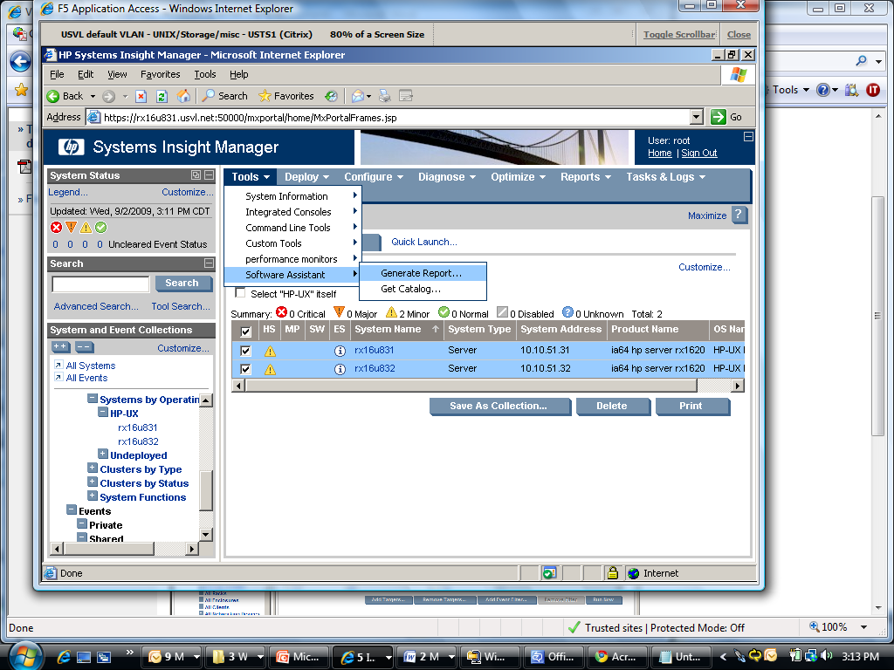
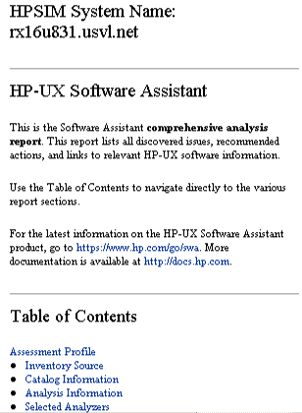
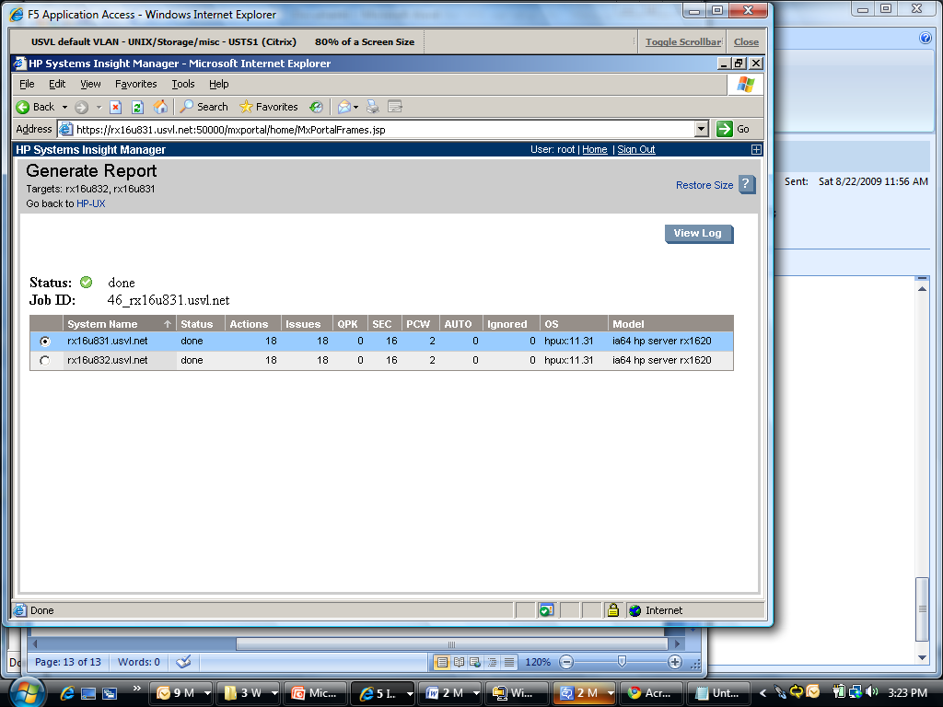
Integrating SWA and HP SIM
HP SIM customers can use it to generate SWA reports across multiple
systems
98

Slide 99
Example of Open-Source SWA Automation
Dusan Baljevic, HP employee, wrote Shell script for full
company-wide SWA management system (free access):
http://www.circlingcycle.com.au/Unix-sources/HP-UX-SWA-global-audit.sh.txt
99
Notes:
[Course Title]
[Module Title]
[Rev. # or date] – HP Restricted

Slide 100
HP-UX Patch Management with Dynamic Root Disk (DRD)

Slide 101
HP-UX DRD: Minimizing Planned Downtime
DRD enables the administrator to create a point-in-time clone of the vg00 volume group:
  Original vg00 image remains active;
  Cloned vg00 image remains inactive until needed;
  Unlike boot disk mirrors, DRD clones are unaffected by vg00 changes.
DRD is an optional, free product on the 11i v2 and v3 application media.
Install patches
on the clone;
applications
remain running
lvol1
lvol2
lvol3
lvol1
lvol2
lvol3
lvol1
lvol2
lvol3
lvol1
lvol2
lvol3
boot disk
boot mirror
clone disk
clone mirror
vg00 (active)
cloned vg00 (inactive/patched)
Activate the
clone to make
changes take
effect
lvol1
lvol2
lvol3
lvol1
lvol2
lvol3
lvol1
lvol2
lvol3
lvol1
lvol2
lvol3
boot disk
boot mirror
clone disk
clone mirror
vg00 (inactive)
cloned vg00 (active/patched)
101

Slide 102

DRD Clones Minimize Unplanned Downtime
Without DRD: In case of O/S mis-configuration, it may be necessary to restore from tape.
With DRD: In case of O/S mis-configuration, simply activate and boot the clone.
Original
boot VG is
corrupted
lvol1
lvol2
lvol3
lvol1
lvol2
lvol3
lvol1
lvol2
lvol3
lvol1
lvol2
lvol3
boot disk
boot mirror
clone disk
clone mirror
original vg00 (unusable)
cloned vg00 (inactive)
So activate
the clone!
lvol1
lvol2
lvol3
lvol1
lvol2
lvol3
lvol1
lvol2
lvol3
lvol1
lvol2
lvol3
boot disk
boot mirror
clone disk
clone mirror
original vg00 (unusable)
cloned vg00 (active)
102

Slide 103
DRD Clones Minimize Planned Downtime
Without DRD: Software and kernel management may require extended downtime.
With DRD: Install/remove software on the clone while applications continue running.
Install patches &
tune the kernel
on the clone;
applications
remain running
lvol1
lvol2
lvol3
lvol1
lvol2
lvol3
lvol1
lvol2
lvol3
lvol1
lvol2
lvol3
boot disk
boot mirror
clone disk
clone mirror
vg00 (active)
cloned vg00 (inactive/patched)
Activate the
clone to make
changes take
effect
lvol1
lvol2
lvol3
lvol1
lvol2
lvol3
lvol1
lvol2
lvol3
lvol1
lvol2
lvol3
boot disk
boot mirror
clone disk
clone mirror
vg00 (inactive)
cloned vg00 (active/patched)
103

Slide 104
HP-UX DRD Pros 1 of 2
Fully supported by HP.
Full clone.
Complements other HP solutions by reducing system downtime required to install and update patches and software.
Copy operation is currently done by fbackup and frecover.
kctune command can be used to modify kernel parameters in the clone.
The ioconfig file and the entire /dev directory are copied by the DRD clone operation, so instance numbers will not change when the clone is booted.*
Supports nPars, vPars, and Integrity VMs.

Slide 105
HP-UX DRD Pros 2 of 2
No tape drive is needed.
No impact on network performance.
No security issues of transferring data across the network.
All DRD processes, including drd clone and drd runcmd, can be safely interrupted issuing Control-C (SIGINT) from the controlling terminal or by issuing kill -HUP<pid> (SIGHUP). This action causes DRD to abort processing and perform any necessary clean up. Do not interrupt DRD using the kill -9 <pid> command (SIGKILL), which fails to abort safely and does not perform cleanup.

Slide 106
HP-UX DRD Cons 1 of 3
Target disk must be a single disk or mirror group only.
Not easy to list all differences between Active and Inactive image (drd sync * is the simplistic option).
Cloning should be done when the server’s activity is at a minimum.
DRD can clone root volume group that is spread across multiple disks. The target must be a single disk or mirrored pair.
Notes:
* To verify differences:
# diff /etc/passwd /var/opt/drd/mnts/sysimage_001/etc/passwd
For example, in Solaris, the whole comparison is automated:
# lustatus
Boot Environment Is Active Active Can Copy
Name Complete Now On Reboot Delete Status
-------------------------- -------- ------ --------- ------ ----------
d30 yes yes yes no -
BE2 no no no no ACTIVE
# lufslist BE1
# lufslist BE2
# lucompare BE2

Slide 107
HP-UX DRD Cons 2 of 3
Contents of root volume group are copied. A system that has /opt (or any file system that is patched) not in root volume group is not suitable for use with DRD.
Does not provide a mechanism for resizing file systems during a DRD clone operation. However, after the clone is created, you can manually change file system sizes on the inactive system without needing an immediate reboot. The whitepaper, Using the Dynamic Root Disk Toolset describes resizing file systems other than /stand. The whitepaper Using the DRD toolset to extend the /stand file system in an LVM environment describes resizing the boot (/stand) file system on an inactive system image.
Current release of DRD does not copy the Itanium Service Partition (s3 or _p3).

Slide 108
HP-UX DRD Cons 3 of 3
Command /opt/drd/lbin/drd_scan_hw_host hangs occasionally. This is a hardware issue as it is trying to scan all connected hardware. Check it before using DRD and maybe even remove stale devices with rmsf –x if necessary:
# ioscan -s
# lssf -s
Too many tiny files on root disks can cause significant performance problem when DRD is used.
We might see the following error message during the execution of drd runcmd if the nsswitch.conf file contains the "hosts: nis" entry:
Error: Could not contact host "myserver". Make sure the hostname is correct and an absolute pathname is specified (beginning with "/").
We might see the following error message during the execution of drd runcmd if the nsswitch.conf file contains the "passwd: compat" or "group: compat" entries:
Error: Permission is denied for the current operation. There is no entry for user id 0 in the user database. Check /etc/passwd and/or the NIS user database.

Slide 109
Installing DRD
DRD is included in current 11i v2 and v3 operating environments or ...
Download and install DRD from http://software.hp.com
Install DRD with swinstall (no reboot required)
# swinstall –s /tmp/DynRootDisk*.depot DynRootDisk
109

Slide 110
DRD Commands
Most DRD tasks require a single command, drd, which supports multiple “modes”.
Example
# drd clone –t /dev/disk/diskY –x overwrite=true
Other available modes
# drd view available modes and options
# drd clone ... create a DRD clone
# drd mount ... mount the DRD clone’s file systems
# drd umount ... unmount the DRD clone’s file systems
# drd runcmd ... execute a command on the clone’s file systems
# drd activate ... make the DRD clone the default boot disk after next reboot
# drd deactivate retain the current active image as the default boot disk
# drd status display information about active/inactive DRD images
DRD offers several common options that are supported in all modes
# drd mode -? view available options
# drd mode –x ? view available extended options
# drd mode [-x verbosity=3] ... specify stdout/stderr verbosity, 0-5
# drd mode [-x log_verbosity=4] ... specify log file verbosity, 0-5
# drd mode [-qqq|qq|q|v|vv|vvv] ... alternative to –x verbosity=n
# drd mode [–p] ... preview but don’t execute the operation
110

Slide 111
Creating and Updating DRD Clone
Use the drd clone command to create a DRD clone of the active boot disk:
  DRD identifies the current active boot disk
  DRD builds a similarly structured clone disk
  DRD copies the current disk’s file system contents to the clone
  DRD builds a mirror of the clone, too, if requested
  DRD records log messages in /var/opt/drd/drd.log
Identify available disk(s)
# ioscan –funC disk list all disks on the system
# lvmadm –l or strings /etc/lvmtab* which disks are LVM disks?
# vxdisk list which disks are VxVM disks?
# diskinfo /dev/rdisk/disk3 verify the disk size
Clone the current active boot disk
# drd clone –t /dev/disk/disk3 \ specify a target disk (required!)
[–x overwrite=true] \ overwrite data on target
[-x mirror_disk=/dev/disk/disk4] create a mirror of the DRD
Update an existing clone (overwrite=true required!)
# drd clone –t /dev/disk/disk3 \ specify a target disk (required!)
–x overwrite=true \ overwrite data on target
[-x mirror_disk=/dev/disk/disk4] create a mirror of the DRD
111
Notes:
[Course Title]
[Module Title]
[Rev. # or date] – HP Restricted

Slide 112
Verifying DRD Clone Status
# drd status
======= 07/23/08 12:13:57 EDT BEGIN Displaying DRD Clone Image Information (user=root) (jobid=myhost)
* Clone Disk: /dev/disk/disk3
* Clone EFI Partition: Boot loader and AUTO file present
* Clone Creation Date: 07/18/08 21:07:29 EDT
* Clone Mirror Disk: None
* Mirror EFI Partition: None
* Original Disk: /dev/disk/disk1
* Original EFI Partition: Boot loader and AUTO file present
* Booted Disk: Original Disk (/dev/disk/disk1)
* Activated Disk: Original Disk (/dev/disk/disk1)
======= 07/23/08 12:14:04 EDT END Displaying DRD Clone Image Information succeeded. (user=root) (jobid=myhost)
112
Notes:
[Course Title]
[Module Title]
[Rev. # or date] – HP Restricted
If you run drd activate and then decide not to activate the inactive system image, you have the following options for undoing activation of the inactive system image:
Look through /var/opt/drd/drd.log to find messages indicating the previous primary boot path, the run setboot –p to set the primary boot path to that disk.
Run vgdisplay –v to determine the disk containing vg00, then run ioscan –fnkC disk to determine the hardware path corresponding to the disk, then run setboot –p to set the primary boot path to that disk.
Run cat /stand/bootconf to get the device file of the boot disk, run ioscn –fnkC disk to identify the corresponding hardware path, and then run setboot –p to set the primary boot path.

Slide 113
DRD-Safe Commands
Files in the inactive system image are not accessible, by default, to HP-UX commands.
“DRD-Safe” commands cam be executed on the inactive image via drd runcmd
  Temporarily imports and mounts the inactive image’s volume group and file systems,
  Executes the specified command using executables & files on the inactive image,
  Ensures that the active image remains untouched,
  Unmounts and exports the inactive image’s file systems and volume group.
DRD-safe commands currently include:
swinstall
swremove
swlist
swmodify
swverify
swjob
kctune
update-ux
view
Notes:
[Course Title]
[Module Title]
[Rev. # or date] – HP Restricted

Slide 114
Managing Patches with DRD-Safe Commands
Installing patches and software sometimes requires a reboot and downtime.
Minimize downtime by installing software/patches/updates on an inactive image.
Changes take effect when you activate and boot the inactive image.
Only DRD-Safe patches/products can be installed via DRD.
List software installed on the inactive image using the DRD-Safe swlist command
# drd runcmd swlist
Check if product or patch is DRD-Safe
# swlist –l fileset –a is_drd_safe product_name|patch
Install software on the inactive image using the DRD-Safe swinstall command
# drd runcmd swinstall –s server:/mydepot PHSS_NNNNN
Remove software from the inactive image using the DRD-Safe swremove command
# drd runcmd swremove PHSS_NNNNN
View the inactive image SDUX log file using the DRD-Safe view command
# drd runcmd view /var/adm/sw/swagent.log
Update to a more recent 11i v3 media kit
# drd runcmd swinstall –s server:/mydepot Update-UX
# drd runcmd update-ux –s server:/mydepot
# drd runcmd view /var/adm/sw/update-ux.log
114
Notes:
[Course Title]
[Module Title]
[Rev. # or date] – HP Restricted

Slide 115
Accessing DRD Inactive Images
The drd runcmd utility only executes DRD-safe executables on an inactive image.
To access other files on the inactive image, mount the image via drd mount
  Imports the inactive image volume group, typically as drd00,
  Mounts the image file systems under /var/opt/drd/mnts/sysimage_001
Warnings:
  Be careful not to unintentionally modify the active system image!
  Only use read-only commands like view and diff to access inactive images.
Mount the inactive image file systems
# drd mount
# mount -v
Access the inactive image file systems, being careful not to modify the active image!
# diff /etc/passwd /var/opt/drd/mnts/sysimage_001/etc/passwd
Unmount the inactive image file systems
# drd umount
115
Notes:
[Course Title]
[Module Title]
[Rev. # or date] – HP Restricted

Slide 116
DRD Inactive Image Synchronization
The drd sync command was introduced in release B.11.xx.A.3.5 of Dynamic Root Disk (DRD) to propagate root volume group file system changes from the booted original system to the inactive clone image. Running drd sync command updates/creates the files on Inactive Image (Clone Disk) which were modified on Active Image (Boot Disk) after last successful execution of drd clone command.
To preview differences between the Active Image and the DRD Inactive Image
# drd sync –p
It creates file /var/opt/drd/sync/files_to_be_copied_by_drd_sync
Once the preview is checked, a resync of the cloned image can be initiated
# drd sync
116
Notes:
[Course Title]
[Module Title]
[Rev. # or date] – HP Restricted

Slide 117
Activating and Deactivating Inactive DRD Image
Use drd activate to make the inactive image the primary boot disk
  DRD updates the boot menu
  DRD can optionally reboot the system immediately
Promote the inactive system image to become primary boot disk (with preview)
# drd activate [-x reboot=false] -p
If –x reboot=true wasn’t specified, manually reboot
# shutdown –ry 0
If you change your mind before rebooting, use drd deactivate to undo the activation
# drd deactivate
Use drd status to determine which disk is the currently active boot disk
# drd status
117
Notes:
[Course Title]
[Module Title]
[Rev. # or date] – HP Restricted

Slide 118
HP-UX DRD Examples for Different O/S
HP-UX 11iv2:
# drd clone -t /dev/dsk/c2t1d0 -x \
overwrite=true [-x mirror_disk=/dev/dsk/c3t0d1]
HP-UX 11iv3, use agile views:
# drd clone -t /dev/disk/disk32 -x \
overwrite=true [-x mirror_disk=/dev/disk/disk4]
Note that all partitions on Itanium disk are created, and s1 and s2
(_p1 and _p2) are copied.

Slide 119
HP-UX DRD Examples How to Select Software
To exclude single product T1458AA
# drd runcmd update-ux -p –s \
svr:/var/opt/HPUX_1131_0903_DCOE HPUX11i-DC-OE \
!T1458AA
Use -f software_file * to read the list of sw_selections from software_file instead of (or in addition to) the command line
# drd runcmd update-ux -s source_location \
-f software_file
Notes:
* For deselecting software/products, sw_selection, the file should contain !sw_selection , like for example:
!selection
or [bundle]/[%match]
or pattern-matching-expression

Slide 120
HP-UX DRD Rehost Cookbook 1 of 2
Clone the host1 system to a shared LUN
# drd clone -t /dev/disk/diskX
Create a system information file for host2
# vi /tmp/sysinfo_host2
SYSINFO_HOSTNAME=host2
SYSINFO_DHCP_ENABLE[0]=0
SYSINFO_MAC_ADDRESS[0]=0x1edb3adea7ab
SYSINFO_IP_ADDRESS[0]=172.16.19.184
SYSINFO_SUBNET_MASK[0]=255.255.255.0
SYSINFO_ROUTE_GATEWAY[0]=172.16.19.1
SYSINFO_ROUTE_DESTINATION[0]=default
SYSINFO_ROUTE_COUNT[0]=1

Slide 121
HP-UX DRD Rehost Cookbook 2 of 2
Execute the drd rehost command, specifying the system information file created in the previous step.
# drd rehost -f /tmp/sysinfo_host2
Unpresent the LUN from the host1, and present it to the host2.
Choose the new LUN from the boot screens and boot the host2.
On both hosts reinitialize the DRD configuration by deleting the registry
# rm -f /var/opt/drd/registry/registry.xml
Remove the Device Special File of the boot device of the host2
# rmsf -H 64000/0xfa00/0x6

Slide 122
HP-UX DRD Expand Root File System with DRD 1 of 3
For this example, we assume vg00 has only one disk (disk0) in LVM L1
and the DRD will hold on disk5. Note, however, that support procedure for
extending the root filesystem is using Ignite-UX!
Create a clone of the root filesystem
# drd clone -v -x overwrite=true -t /dev/disk/disk5
Mount the DRD filesystem as vgdrd
# mkdir /dev/vgdrd
# mknod /dev/vgdrd/group c 64 0x0a0000
# vgimport /dev/vgdrd /dev/disk/disk5
# vgchange -a y vgdrd
NOTE: The minor number must be unique on the server.

Slide 123
HP-UX DRD Expand Root File System with DRD 2 of 3
Create a new lvol to hold lvol4
# lvcreate -l <lvol4_size> -n lvtmp /dev/vgdrd
Copy the data from lvol4 to lvtmp
# dd if=/dev/vgdrd/lvol4 of=/dev/vgdrd/lvtmp bs=1024
Remove lvol4
# lvremove /dev/vgdrd/lvol4
Assume that there is a need to get to 450 PE on root
# lvextend -l 450 /dev/vgdrd/lvol3
Recreate lvol4 and move the data back:
# lvcreate -l <lvol4_size> -n lvol4 /dev/vgdrd
# dd if=/dev/vgdrd/lvtmp of=/dev/vgdrd/lvol4 bs=1024

Slide 124
HP-UX DRD Expand Root File System with DRD 3 of 3
Check the size change
# vgdisplay -v vgdrd
Remove the DRD volume group
# vgexport vgdrd
Boot from the DRD volume
# /opt/drd/bin/drd activate -x reboot=true

Slide 125
Thank You

