Slide 1
HP-UX 11iv3 Ignite-UX with NFSV4 and SSH Tunnel
Dusan Baljevic

Slide 2
Overview
This short technical presentation will show:
  Setup of Ignite-UX server and client running HP-UX 11iv3 by using NFSv4 with SSH tunnel
Assumptions:
  Basic knowledge of Ignite-UX, SSH, and NFS on HP-UX platform
The equipment used:
  rx7420 and rx2660 running HP-UX 11iv3 Update 1203
  Ignite-UX server hostname is ignserv
  Ignite-UX client hostname is hpclient
  Both servers run HP-UX DCOE, OpenSSH 6.0p1 (GR8 Call 4000252191 opened for Secure Shell on HP-UX), Ignite-UX C.7.14.264, ONC/NFS B.11.31.13
  Network between the servers is plain 100 Mbs segment, the servers use single network cards (no APA)
  Default kernel tuning was used

Slide 3
Secure Shell 5.9p1 Still a Problem
  Even the latest version of HP-UX 11iv3 1209 DCOE with its Secure Shell has the same bug. I tested it in early September 2012.
  The same “hung-session” problem occurred when using:
  # swlist | egrep "\-OE"
  HPUX11i-DC-OE B.11.31.1209 HP-UX Data Center Operating Environment
  # ssh -V
  OpenSSH_5.9p1+sftpfilecontrol-v1.3-hpn13v12, OpenSSL 0.9.8w 23 Apr 2012
  HP-UX Secure Shell-A.05.90.007, HP-UX Secure Shell version
  So, at this stage, open-source version of SSH is still required on the Ignite-UX client side. The Ignite-UX server side uses standard Secure Shell that comes with HP-UX distribution.

Slide 4
Why This Presentation?
  Secure environment to run Ignite-UX when only SSH is allowed between servers;
  An alternative solution to run Ignite-UX, which was not documented before;
  An opportunity to use new features through NFSv4;
  The flexibility of tools available on HP-UX 11iv3;
  Simple and robust solution for Disaster Recovery O/S backups in secure environments.

Slide 5
Why NFSv4 with SSH Tunnel
With HP-UX 11i we support Kerberos encryption with all NFS-versions (NFSv2, NFSv3, and NFSv4);
This would possibly be faster than port forwarding with SSH, but the NFS ports would still need to be opened between two servers;
With NFSv4 and SSH tunnel, a new method is possible, where Ignite-UX and pre-mounted file systems (NFS) can be used. In this case, we will use localhost as target for saving the O/S image:
make_net_recovery –s localhost ...

Slide 6
Setting NFSv4 on Ignite-UX Server
Edit /etc/rc.config.d/nfsconf. The only important options are:
NFS_CORE=1
LOCKMGR=1 *
NFS_SERVER=1
NFS_CLIENT=0
START_MOUNTD=1
Edit /etc/default/nfs and change the following options from the defaults:
NFS_SERVER_VERSMAX=4
NFS_CLIENT_VERSMAX=4
Notes:
* Without LOCKMGR being enabled, the following error is displayed on the client when NFS mount is attempted:
# mount -o port=2323,vers=4 localhost:/var/opt/ignite/clients /var/opt/ignite/recovery/client_mnt
channel 2: open failed: administratively prohibited: open failed
nfs mount: localhost NFS service not available RPC: Success
nfs mount: retrying: /var/opt/ignite/recovery/client_mnt
channel 2: open failed: administratively prohibited: open failed
nfs mount: giving up on: /var/opt/ignite/recovery/client_mnt

Slide 7
NFSv4 Delegation *
/etc/default/nfs option (NFS_SERVER_DELEGATION=on).
NFSv4 is designed to use a single source-port 2049. If there is a firewall between NFS
client and NFS-server, it is sufficient to open port number 2049. With the introduction of
NFSv4 delegation, the NFS-server need to be able to revoke a granted delegation. This is
done via a special connection/protocol and requires an additional port to be opened.
The communication is done from the NFS-server to the NFS-client, and the destination port of
this connection is announced/sent by the NFS-client, when the NFSv4 file system is been
mounted.
The port-number that is currently used can be any port between 49152 and 65535 and is
handled by the NFSv4 callback-daemon "nfs4cbd“ at the NFS-client. If the firewall blocks the
callback-communication, the NFS-client and NFS-server will disable the delegation feature
for this client, which may impact NFSv4 performance (does not impact NFSv4 functionality).
Notes:
* SAW document http://sawpro.atlanta.hp.com/km/saw/view.do?docId=ttr_na-SSB_100120996
9&hsid=42564915&sz=1823
There is no command/tool that can be used to
determine if the delegation feature is enabled or disabled.

Slide 8
Setting NFSv4 on Ignite-UX Server – cont.
Edit /etc/dfs/dfstab to share two file systems to a remote Ignite-UX client (hostname hpclient). It is CRUCIAL to list both the Ignite-UX server and client in the access list:
share -F nfs -o anon=2,access=ignserv:hpclient /var/opt/ignite/clients
share -F nfs -o anon=2,access=ignserv:hpclient /var/opt/ignite/recovery/archives/hpclient
Warning: If you do not put the Ignite-UX server above, the client will
report the following error in /var/adm/syslog/syslog.log:
Aug 28 17:47:12 hpclient vmunix: WARNING: NFS server initial call to
localhost failed: Permission denied

Slide 9
Setting SSH on Ignite-UX Server
Edit /usr/local/etc/sshd_config. The only important changes from the defaults are:
Protocol 2,1
ClientAliveInterval 15
ClientAliveCountMax 10
ClientAliveInterval sets a timeout interval in seconds after which if no data has been received from the client, sshd(8) will send a message
through the encrypted channel to request a response from the client. The default is 0, indicating that these messages will not be sent to the client. This option applies to SSH protocol version 2 only.

Slide 10
Setting SSH on Ignite-UX Server cont.
ClientAliveCountMax Sets the number of client alive messages which may be sent without sshd receiving any messages back from the client.
If this threshold is reached while client alive messages are being sent, sshd will disconnect the client, terminating the session. It is important to note that the use of client alive messages is very different from TCPKeepAlive (below). The client alive messages are sent through the encrypted channel and there- fore will not be spoofable. The TCP keepalive option enabled by TCPKeepAlive is spoofable. The client alive mechanism is valuable when the client or server depend on knowing when a connection has become inactive. The default value is 3. If ClientAliveInterval is set to 15, and ClientAliveCountMax is 10, unresponsive ssh clients will be disconnected after approximately 150 seconds.

Slide 11
Setting NFSV4 on Ignite-UX Client
Edit /etc/rc.config.d/nfsconf. The only options required are:
NFS_CORE=1
LOCKMGR=1 *
NFS_CLIENT=1
Edit /etc/default/nsf and change the following options from the defaults:
NFS_SERVER_VERSMAX=4
NFS_CLIENT_VERSMAX=4
Notes:
* Without LOCKMGR being enabled, the following error is displayed on the client when NFS mount is attempted:
# mount -o port=2323,vers=4 localhost:/var/opt/ignite/clients /var/opt/ignite/recovery/client_mnt
channel 2: open failed: administratively prohibited: open failed
nfs mount: localhost NFS service not available RPC: Success
nfs mount: retrying: /var/opt/ignite/recovery/client_mnt
channel 2: open failed: administratively prohibited: open failed
nfs mount: giving up on: /var/opt/ignite/recovery/client_mnt

Slide 12
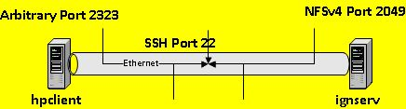
SSH Tunnel On Ignite-UX Client
Set up SSH tunnel to Ignite-UX server. We used local port 2323 (can be any free port on the local machine) :
# /usr/local/bin/ssh -fN -L 2323:ignserv:2049 ignserv
It means we established an SSH tunnel by using local port 2323 to tunnel requests to remote server ignserv on port 2049.

Slide 13
Create Directory on Ignite-UX Client
# mkdir -p /var/opt/ignite/recovery/client_mnt
# chown bin:bin /var/opt/ignite/recovery/client_mnt
# mkdir /var/opt/ignite/recovery/arch_mnt
# chown bin:bin /var/opt/ignite/recovery/arch_mnt

Slide 14
Change Commands on Ignite-UX Client
Once the tunnel is established to a remote Ignite-UX server, the following TEMPORARY command changes are required:
# mv /sbin/mount /sbin/mount.IGN
# mv /sbin/umount /sbin/umount.IGN
# ln –s /usr/bin/true /sbin/mount
# ln –s /usr/bin/true /sbin/umount
# cp /opt/ignite/bin/save_config /opt/ignite/bin/save_config.IGN
# sed -e 's/^mount -lp/mount.IGN -lp/g‘ /opt/ignite/bin/save_config \
> /opt/ignite/bin/save_config.new
# mv /opt/ignite/bin/save_config.new /opt/ignite/bin/save_config

Slide 15
QXCR1001169724 Ignite-UX with pre-mounted NFS
To enable the migration of systems in secure environments this request asks for a method of telling make_net_recovery to not NFS mount file
systems and write the configuration and archive to local disks.
The general requirement is that make_net_recovery allow the use
of no NFS file systems. That is: it will write the configuration and archive to a the local file system instead of a remote NFS file system.
http://psweb1.cup.hp.com/~projects/pq/cgi-bin/goto_cr.cgi?number=QXCR1001169724&results_format=default&tz=PDT&submit=submit

Slide 16
NFSv4 Mounts on Ignite-UX Client
Once the tunnel is established to a remote Ignite-UX server, two NFSv4 file systems must be mounted on the client. We used local port 2323 (can be any free port) and remote Ignite-UX server is hostname ignserv:
# /sbin/mount.IGN -o port=2323,vers=4 \
localhost:/var/opt/ignite/clients /var/opt/ignite/recovery/client_mnt
# /sbin/mount.IGN -o port=2323,vers=4 \
localhost:/var/opt/ignite/recovery/archives/hpclient \
/var/opt/ignite/recovery/arch_mnt

Slide 17
Ignite-UX Backups on Client
localhost is used for make_net_recovery:
# make_net_recovery -s localhost -P s -x inc_entire=vg00 –x \ exclude=/tmp -x exclude=/var/tmp -d "Archive_of_hpclient_via_NFSv4“

Slide 18
Ignite-UX Client NFS Mounts
# bdf
Filesystem kbytes used avail %used Mounted on
/dev/vg00/lvol3 2097152 686912 1399336 33% /
/dev/vg00/lvol1 2097152 253368 1829440 12% /stand
/dev/vg00/lvol8 12288000 2655544 9557288 22% /var
/dev/vg00/lvol10 2097152 20376 1949780 1% /var/tmp
/dev/vg00/lvol9 4194304 18008 3915285 0% /var/adm/crash
/dev/vg00/lvol7 12288000 3759744 8461736 31% /usr
/dev/vg00/lvol6 1048576 21088 1019464 2% /tmp
/dev/vg00/lvol5 18432000 8646536 9709152 47% /opt
/dev/vg00/lvol4 524288 20848 499512 4% /home
localhost:/var/opt/ignite/clients 16252928 4258160 11901208 26% /var/opt/ignite/recovery/client_mnt
localhost:/var/opt/ignite/recovery/archives/hpclient 16252928 4258168 11901208 26% /var/opt/ignite/recovery/arch_mnt

Slide 19
Ignite-UX Backups on Client
Ignite-UX backups of around 5.8 GB image took 58 minutes across 100 Mbs network segment (idle network) when using NFSv4 and SSH tunnel.
Ignite-UX backups of around 5.8 GB image took 48 minutes across 100 Mbs network segment (idle network) when using NFSv4 without SSH tunnel.
Through limited testing, it has been shown that SSH tunnel might decrease network throughput by up to around 20%.
Through performance monitoring, it was found out that around 1.4 GB of RAM was used during Ignite-UX backups of 5.8 GB on the client.
Through kernel, NFS and VxFS tuning, even better results would be expected.

Slide 20
Test 1 with TCP and Kernel Tuning
The following changes were tested several times (results were close in timings):
# ndd -set /dev/tcp tcp_recv_hiwater_def 1048576 (on server and client)
# ndd -set /dev/tcp tcp_xmit_hiwater_def 1048576 (on server and client)
# kctune -b yes nfs4_bsize=1048576 (on server and client)
# kctune -b yes nfs4_max_threads=32 (on client)
# kctune -b yes nfs4_nra=32 (on client)
In addition, Tune-N-Tools optimization done on both servers.
Ignite-UX backups of around 5.8 GB image took 74 minutes across 100 Mbs network segment (idle network) when using NFSv4 and SSH tunnel. The tuning did not achieve significantly positive results.

Slide 21
Test 2 with TCP and Kernel Tuning
The following changes were tested several times (results were close in timings):
# ndd -set /dev/tcp tcp_recv_hiwater_def 1048576 (on server and client)
# ndd -set /dev/tcp tcp_xmit_hiwater_def 1048576 (on server and client)
# kctune -b yes nfs4_bsize=1048576 (on server and client)
In addition, Tune-N-Tools optimization done on both servers.
Ignite-UX backups of around 5.8 GB image took 75 minutes across 100 Mbs network segment (idle network) when using NFSv4 and SSH tunnel. The tuning did not achieve significantly positive results.

Slide 22
Test 3 with TCP and Kernel Tuning
The following changes were tested:
# kctune -b yes nfs4_bsize=1048576 (on server and client)
In addition, Tune-N-Tools optimization done on both servers.
Ignite-UX backups of around 5.8 GB image took 75 minutes across 100 Mbs network segment (idle network) when using NFSv4 and SSH tunnel. The tuning did not achieve significantly positive results.

Slide 23
Change Commands on Ignite-UX Client
Once backups are completed on the Ignite-UX client, the following TEMPORARY command changes must be removed:
# rm /sbin/mount /sbin/umount
# mv /sbin/mount.IGN /sbin/mount
# mv /sbin/umount.IGN /sbin/umount
# mv /opt/ignite/bin/save_config.IGN /opt/ignite/bin/save_config
If a crash or a reboot happens while the Ignite-UX Backups are running, you must boot into single user mode and run the above commands before booting cleanly.

Slide 24
Ignite-UX Recovery
archive_cfg file will contain wrong NFS source if you decide to try to restore it. Before unmounting the NFSv4, edit the file:
/var/opt/ignite/recovery/client_mnt/hpclient/recovery/latest/archive_cfg
and change the following statement accordingly:
nfs_source="127.0.0.1:/var/opt/ignite/recovery/archives/hpclient"
Or, on Ignite-UX server, the same file is in this location:
/var/opt/ignite/clients/hpclient/recovery/latest/archive_cfg

Slide 25
Ignite-UX Recovery cont.
The image is located on the Ignite-UX server.
Standard Ignite-UX recovery or deployment procedure applies.

Slide 26
For More Information
Ignite-UX Documentation
http://www.hp.com/go/ignite-ux-docs
NFS Services Administration Guide HP-UX 11iv3
http://h20000.www2.hp.com/bc/docs/support/SupportManual/c03231925/c03231925.pdf
Shell script that automates the backup process:
http://www.circlingcycle.com.au/Unix-sources/HP-UX-ignite-via-NFSv4-and-SSH-tunnel.sh.txt

Slide 27
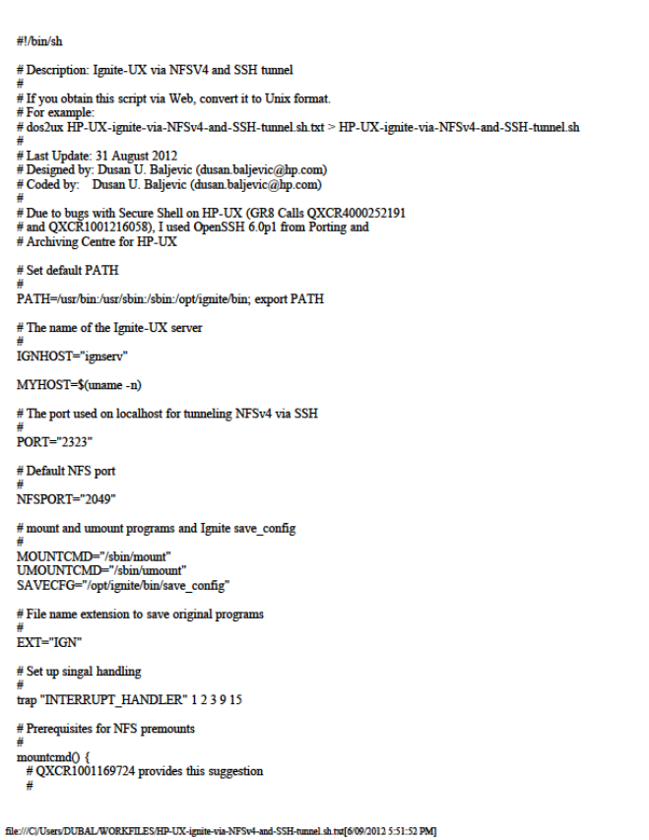
Shell Script (Embedded PDF)

Slide 28
Thank you!

